Slide 1
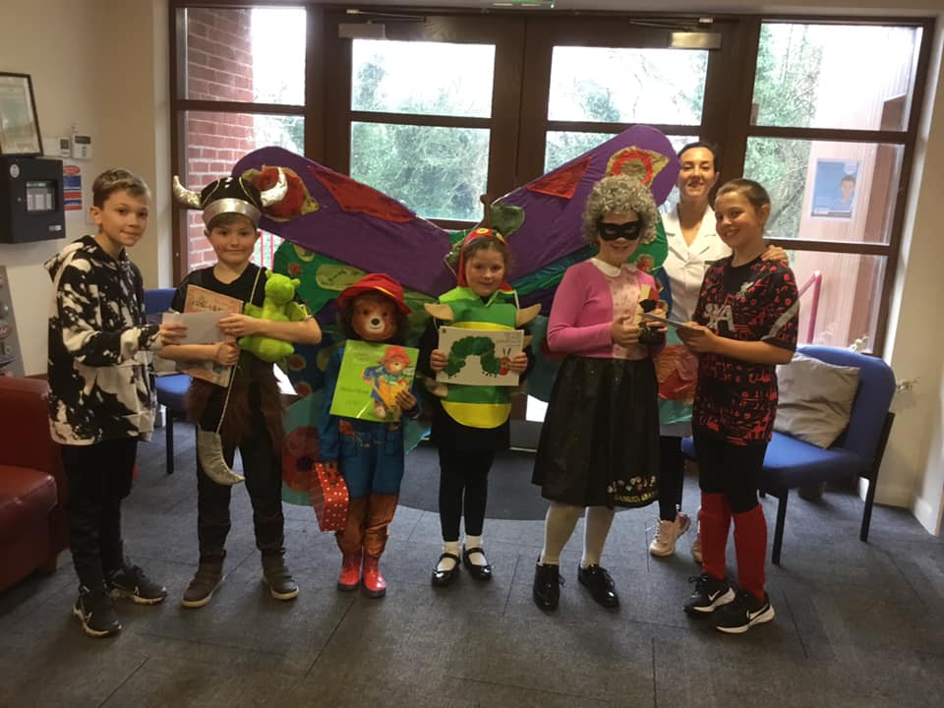
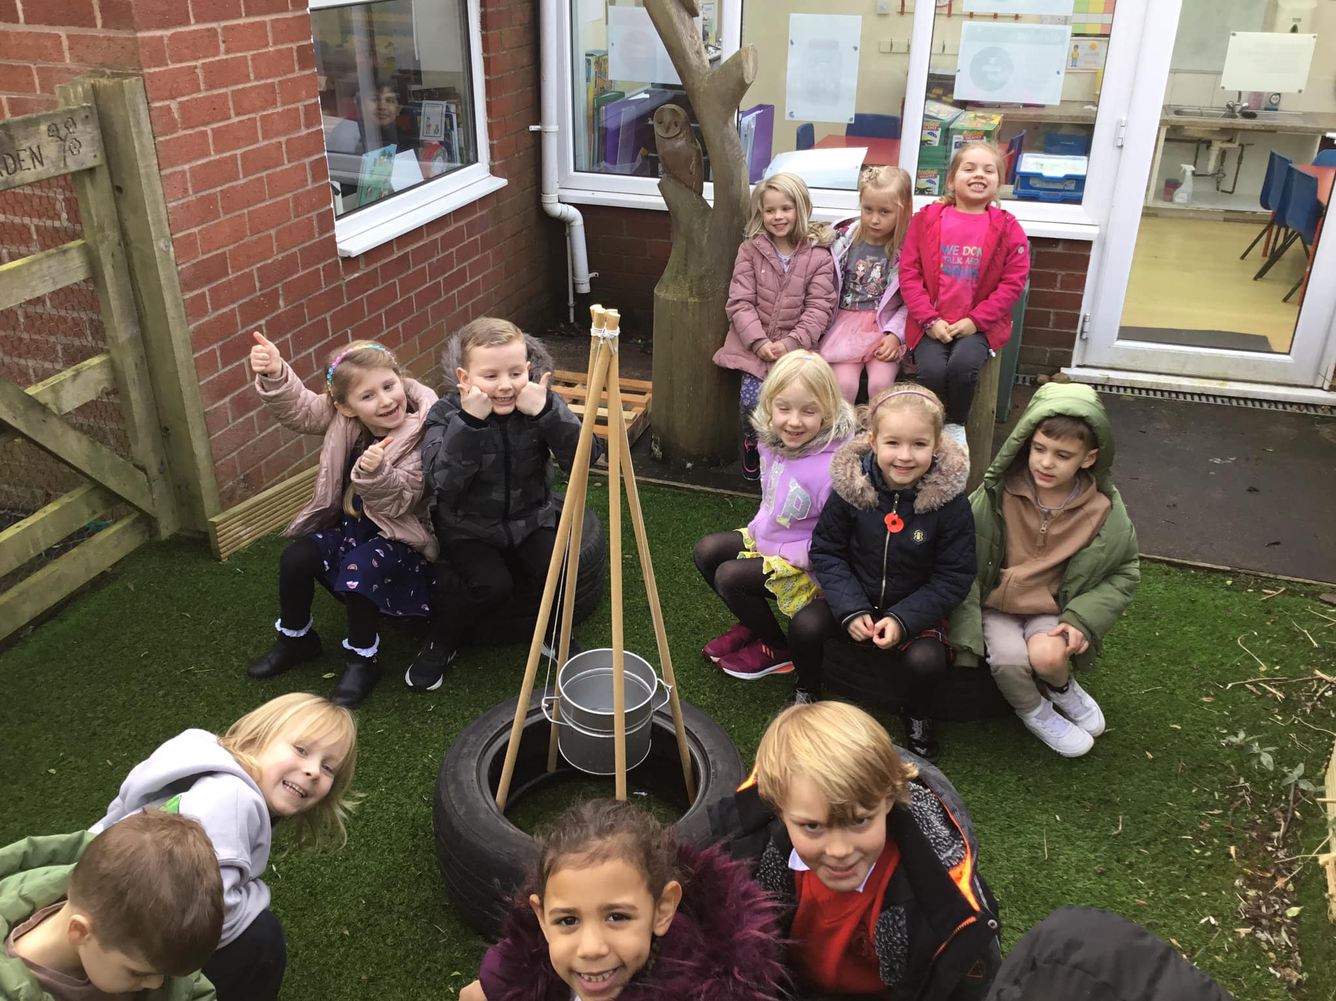
Singleton C of E Primary School
School Improvement Plan 2023 - 24
“Passion for Learning….Passion for Life”
Leadership and Management
Mrs Clayton is going to make sure that staff are trained on helping pupils ‘Progress, Knowing and Remembering More’
Mrs Clayton and Mrs Millward will carry out Learning walks with the JLT – to monitor the school environment and see how it helps with learning. They will discuss with the JLT and get a pupils perspective on what works and what ideas the children have.
We will continue to focus on pupil and staff wellbeing
Quality of Education
Curriculum development – This year we are going to continue to develop Key Assessment Opportunities which will then mean we can help you to help you make progress and know and remember more. We are going to make sure that in lessons, time is spent practicing and recalling what you have previously learnt ‘STICKY KNOWLEDGE’.
Your teachers are also going to make sure that they have knowledge organisers for you to use and that they make online floor books – so that you can go back and have a look to remind yourselves what you have previously learnt.
Behaviour and Attitudes / Personal Development
The staff want to continue to develop play at playtimes. We are going to continue to work with the JLT to introduce a range of different opportunities from fitness challenges to scavenger hunts. Mrs Clayton is going to let us use some of the fundraising money to buy new playground equipment.
We will continue to focus on behaviour and attitudes – the JLT will lead by example and help all children demonstrate exceptional behaviour and attitudes.
Quality of Education
Reading – All the teachers want to help the children at Singleton School to become great readers. They are going to focus on phonics, guided reading comprehension and on further developing vocabulary across the curriculum. Mrs Millward will ensure that staff teach brilliant phonics sessions that help make sure all children are the best readers they can be.
Mrs Clayton is going to make sure that the Staff at Singleton School receive high quality training so that they have the knowledge and skills to teach all children well.
Behaviour and Attitudes / Personal Development
We will continue to focus on developing resilience across school. Having resilience reduces stress and anxiety, it helps us have self esteem and a growth mindset, it also helps us cope with low level behavioural incidents. Mrs Clayton Is going to introduce Outdoor and Adventurous PE with Forest Schools into Fantastic Friday. We also want to deliver parent workshops on behavior so we can all work together.
Quality of Education
The staff team are going to continue to focus on the development of the classroom environments. FS and Y1/2 are getting new furniture. Mrs Millward will focus on further development of working walls, knowledge organisers, displays of children's work. Mrs Millward and Mrs Rund are also very excited about working with the JLT and further developing reading areas in all the classrooms

