Slide 1
Foundation Induction Evening Welcome to Singleton CE Primary School.
Notes:
Good afternoon and welcome, it’s really lovely to see you all. If I could just start by asking you all to put yourselves on mute so there isn’t any background noise.
As this first session is taking place as a virtual meeting it’s more of a welcome and a quick introduction to your child’s first year at school. We recently asked you to collect a pack from school which contains some items which I will refer to, however, if you’ve not been able to collect this yet then please don’t worry, you are still welcome to come after half term. I will go into more detail about the Early Years Foundation Stage curriculum during our second induction evening which will hopefully take place in school where it’s probably easier to ask questions and become more involved.
At Singleton we refer to the first class in our school as ‘Foundation’, in other schools you may hear it being referred to as ‘Reception’, but both names refer to a the first class in Primary School.

Slide 2
This evening you will…
Meet some of the staff here at Singleton
Hear from some of our older children
Watch a video from our Year 5 buddies
Find out about our school uniform
Find out about how you can help your child get ready for starting school
Find out what a typical day in Foundation looks like
Find out what is in your pack

Slide 3
Let’s hear from some of our wonderful older children…
Darcey
Year 5 buddy
Pastoral member of our Junior Leadership Team
Emma
Christian Leader
Pastoral member of our Junior Leadership Team

Slide 4
Introducing our buddies…
See separate video.

Slide 5
School uniform
Notes:
So let’s start by having a quick look at our school uniform, just in case anyone wants to purchase items before our next meeting on Wednesday 7th July. Our uniform is available to buy from Poulton Sports and Trophy Shop.

Slide 6
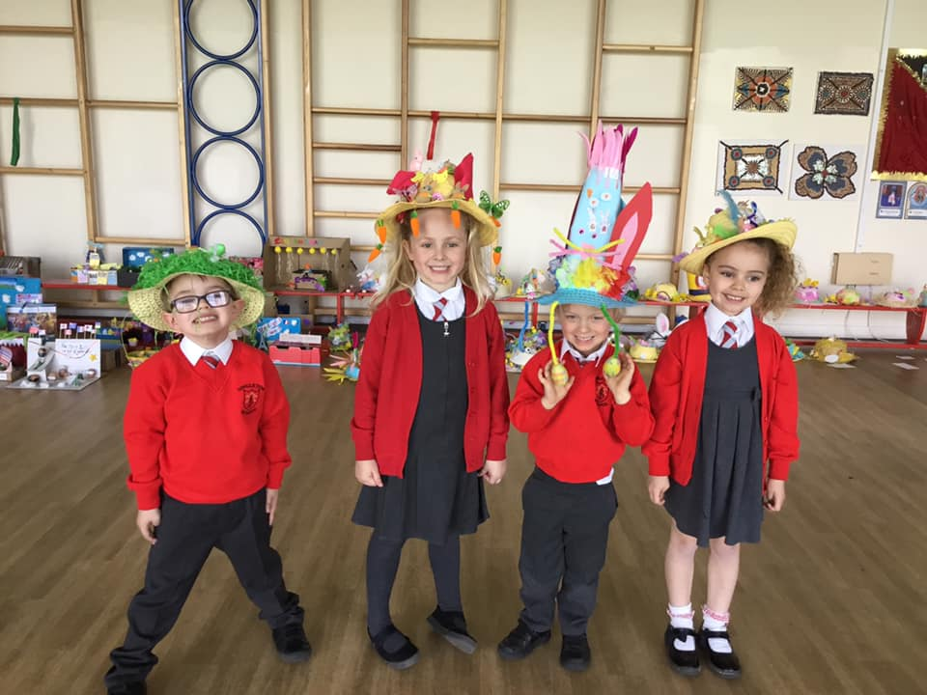
Boy’s uniform
Girl’s uniform
White shirt, school elastic tie, red v-neck school jumper, grey trousers, grey socks and black shoes.
White blouse, school elastic tie, red school cardigan, grey pinafore/skirt, red/grey tights and black shoes.
Summer uniform
Boys can exchange the white shirt for a red school polo shirt with no tie and grey short trousers. Girls can exchange the white blouse and grey pinafore/skirt for a red gingham summer dress and white/red socks.
Notes:
Please put your child’s name in all their belongings, when the classroom gets warm, children take off their jumpers then all of a sudden there are 15 un-named items to try and decipher who they belong to. It’s also helpful to label shoes as we often change into wellies.

Slide 7
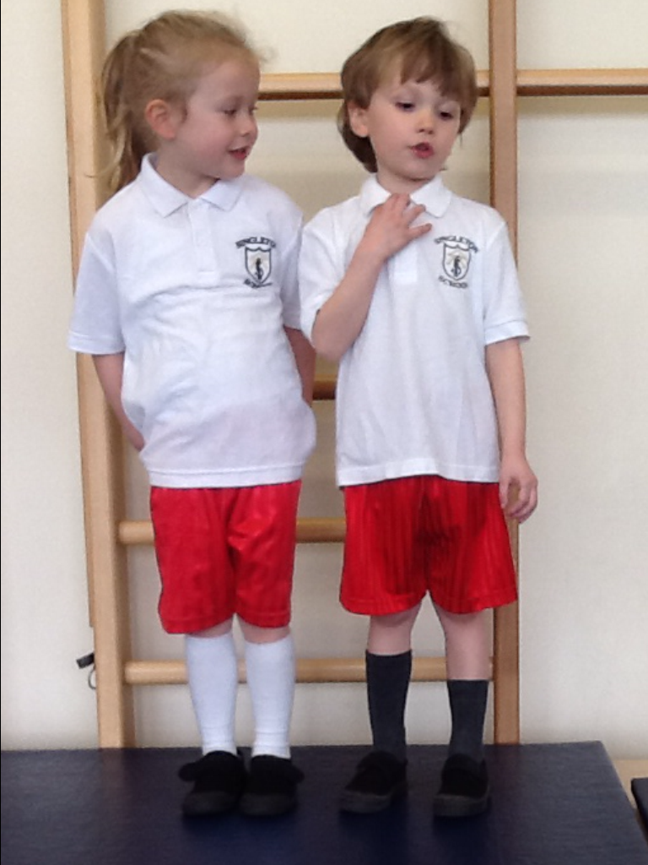
PE kit
White school polo shirt, red shorts, white/grey socks and black pumps/trainers.
In the colder months we allow plain black tracksuit bottoms or leggings. A PE hoodie can also be worn.
Please note children come in dressed in PE kit on PE days.
Children are not permitted to wear any jewellery during P.E. (no earrings)

Slide 8
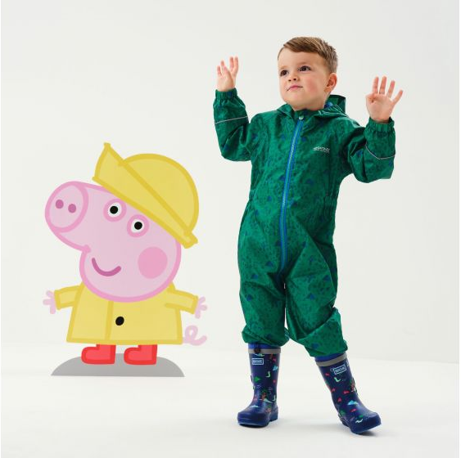
Outdoors
We also politely ask that you provide your child with their own waterproofs and wellies for our outdoor experiences.
We often take our learning outdoors and this is a far more pleasurable experience for our children if they are dressed appropriately and it saves their school uniform getting covered in mud.
“We love jumping in muddy puddles!”

Slide 9
Partnerships with parents
It is important for you and us, as an early years setting to have a strong and respectful partnership. This sets the scene for children to thrive in the early years.
You are the first and ongoing educators of your children and, as such, you will receive regular information and support to help develop your child’s learning at home. By providing homework, feedback during parent's evenings and other regular updates you will feel informed and involved in your child’s education.
It is easier for children to learn when they get encouragement at home. They will do better and achieve more when their parents are involved.
You will also be provided with regular updates of your child’s experiences and learning via Class Dojo and our school Facebook page. Keep an eye out for learning updates and our Facebook posts as these can form a great talking point between yourself and your child.
I am also available on the door at drop off and pick up, if you wish to speak to me. Please don't let things build up, just come and have a chat.
Notes:
READ POINT 1
READ POINT 2 THEN SAY…”Set a regular, quiet time for you and your child to complete their homework. It is so beneficial if you can complete something small everyday, this will likely consist of recalling the phoneme of the day, for example “let’s go on the hunt for items which begin with the letter b” this will help to consolidate what has been taught in school and give your child the confidence to learn more the next day. Homework doesn’t need to be onerous. Just a few pages of reading and some phonics games, hiding letter sounds around the kitchen and asking your child to build words with fridge magnets when you’re making tea. Make it fun, ask your child to count the carrots at you plop them into a pan of water. I will talk more about homework in our next meeting but it really is an important part of your child’s education and setting a good foundation for this when your child starts in Foundation will make the transition to increased homework as they move through school much easier. Set an expectation with your child that homework is a part of family life and enjoy spending quality time with them as they learn.”
READ POINT 4
READ POINT 5

Slide 10
What to expect, when?
We have included a booklet full of information about how you can support your child as they move through the Early Years Foundation Stage.
Notes:
READ THROUGH THIS SLIDE THEN SAY…..”Your child will be entering school in the 30-50 month bracket and will obviously progress through to 40-60 months, with an aim to achieve the Early Learning Goals by the end of their time in Foundation. The Early Learning Goals have now changed but this booklet still provides you with some excellent ideas of how you can support your child to achieve their full potential. It breaks these ideas down into the 7 areas of learning that we focus on in the Early Years Foundation Stage EYFS. I will talk to you in more detail about these 7 areas in our next induction session but as you will see in this booklet they are broken down into the prime areas of communication and language, physical development and personal, social and emotional development, then there are the specific areas of Literacy, Maths, understanding the world and expressive arts. On pages 32 & 33 then 40 & 41 it gives you ideas of how you could support your child at home with their learning, for example in the 30-50 month ideas it says ‘Play listening games with me like ‘Simon Says’ ‘Let me practice using scissors to cut dough, cooked spaghetti or paper and in the 40-60 months it says ‘Play a treasure hunt game with me where I have to listen to your instructions to help me find the next ‘clue’. And ‘Plan a picnic with me and let me decide how many sandwiches and apples we will need.’

Slide 11
How can you help your child get ready for their start in Foundation?
Going to the toilet. Resist the temptation to pop your child onto the loo and wipe their bottom. It is better to get your child into the habit of doing this for themselves as they will be required to do so when they come into school.
Getting dressed. Avoid clothing with fiddly buckles and buttons. It is also a good idea to dress your child in a shirt with a Velcro top button and an elasticated tie on PE days.
Putting on shoes. Tie-up shoes might be a bit difficult. Go for shoes with Velcro fasteners if possible.
Eating. This includes using a knife and fork, opening their lunchbox, and being able to open everything in the lunchbox (some yoghurt tubes and drink cartons can be tricky).
Solving simple problems. Encourage your child to resolve problems by talking when they don’t understand or something isn’t going well. It is important that they also learn when to ask an adult for help.
Notes:
READ THROUGH THE SLIDE THEN SAY….POINT 4 - ”During dinner times the children do not have an incredibly long time to eat their lunch as the older boys and girls follow on from Foundation, so encouraging your child to eat their lunch in a timely manner can help them in their preparation for school.

Slide 12
Help you child to talk
We’ve also included this leaflet in your pack. It provides further information on the typical stages of development for your child as they develop their speech and language.
Communication and Language is one of the prime areas that we focus on in the EYFS.
Notes:
READ THROUGH THE SLIDE THEN SAY…. “The prime areas are important because they lay the foundations for children's success in all other areas of learning and of life. As I mentioned earlier on, by the end of their time in Foundation they should have reached the Early Learning Goals, one of which is to ‘Express their ideas and feelings about their experiences using full sentences, including use of past, present and future tenses.’ one of the things we find some children struggling with is the ability to speak correctly in the past tense, they have a tendency to say things like “I readed a book”, “I builded a house”. If you find your child doing this try to model the sentence correctly to them and ask them to repeat it.

Slide 13
Coming into school on the first day
In our experience, children come into school with far more success, and fewer tears when they say their goodbyes in the playground, as opposed to when their parents accompany them into the classroom. Independence is an essential life skill and one that needs to be nurtured from an early age. Children thrive in a healthy environment where they have opportunities to do more and more for themselves. This also helps them to Develop their sense of responsibility and membership of a community. (EYFS Development Matters Three and Four Years Olds – Prime Areas)
Notes:
On their first day we will ask you to say your goodbyes in the playground before your child comes into school. We did this this year when the children hadn’t even met me and it worked really well, there wasn’t one set of tears and all the children came into school happy and looking forward to new adventures.

Slide 14
What will my child experience whilst in Foundation?
2021-22 saw the start of a new Foundation Stage Curriculum.
Notes:
As I mentioned earlier on, this coming academic year will be the start of a new EYFS curriculum.

Slide 15
The overarching principles of this new curriculum encourage the concepts that:
• every child is a unique child, who is constantly learning and can be resilient, capable, confident and self-assured.
• children learn to be strong and independent through positive relationships.
Notes:
READ THROUGH THE SLIDE…

Slide 16
• children learn and develop well in enabling environments with teaching and support from adults, who respond to their individual interests and needs and help them to build their learning over time. Children benefit from a strong partnership between practitioners and parents and/or carers.
• importance of learning and development. Children develop and learn at different rates.

Slide 17
A typical day in Foundation
Notes:
“Although the EYFS curriculum has changed slightly, it will not have a massive impact on what our children will experience. A typical day in Foundation will still look like this….”

Slide 18
The School Day
Welcome & Carpet Time
This is where the teacher will do some direct teaching.
Storytime & Playtime
Children will enjoy engaging with different stories and they will meet up with their Year 5 buddy at playtime.
Lunchtime & Playtime
Children will eat their lunch in the dining hall then go out to play.
1
3
5
2
4
6
Continuous Provision & Adult Guided Activities
The children will access resources in different areas around the classroom. Continuous Provision encourages children to learn in the absence of an adult. Children will work in groups with an adult to complete a specific task.
Phonics
Continuous Provision & Specific Learning based around some of the 7 Areas, plus RE:
Understanding the World
Expressive Arts & Design
Physical Development
Personal, Social & Health Education
RE
Notes:
Direct Teaching – counting, days of the week, talking about seasons etc…
Continuous Provision – this is where there are a range of areas for the children to access such as a sensory tray, small world area, maths, writing, role play, malleable e.g. play dough. Children will access the different areas and an adult will move round questioning, recording achievement and moving learning on.
Storytime – a really important time for children to interest with a range of books, answering questions, developing vocabulary
Phonics – will learn the letter names and sounds, moving onto digraphs where 2 or 3 letters make one sound
Lunchtime – this takes place in what we call the old hall. I will go in with the children initially then they will be looked after by the dinnertime staff.
Playtime – they will have an opportunity to socialise with their buddies, their peers as well as children from other classes. We have lots of playground toys and games to play.
Afternoon – more continuous provision, trips into the woods, PE, expressive arts, circle time etc…

Slide 19
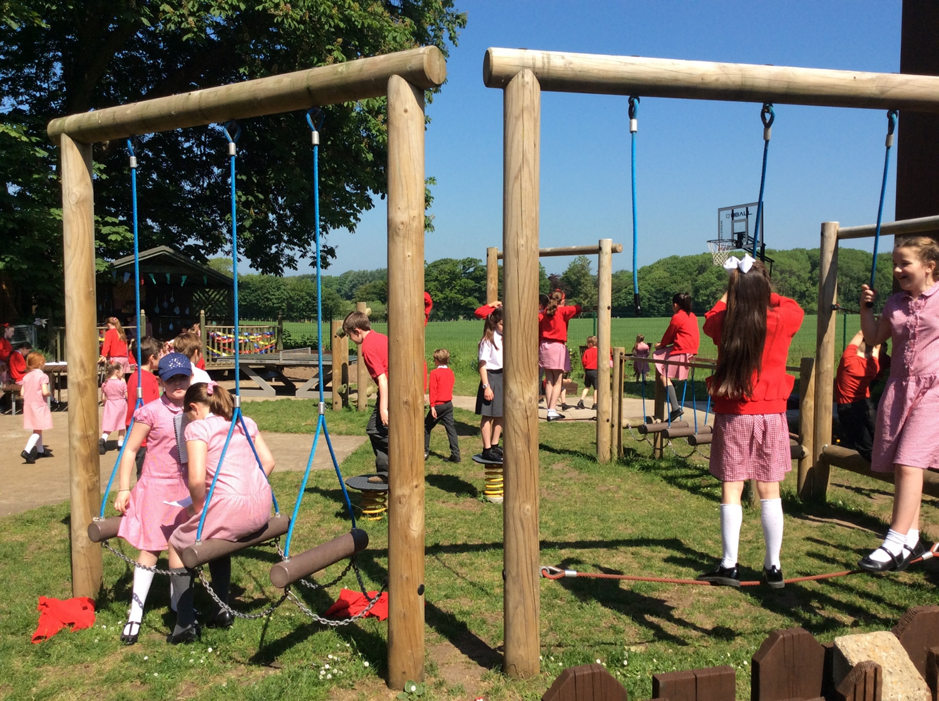
Playtime
Notes:
Here’s a snap shot of what playtime and lunchtime look like.

Slide 20
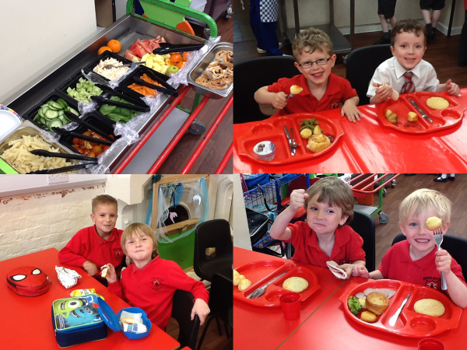
Lunchtime
Lunchtime

Slide 21
What experiences will my child have?

Slide 22
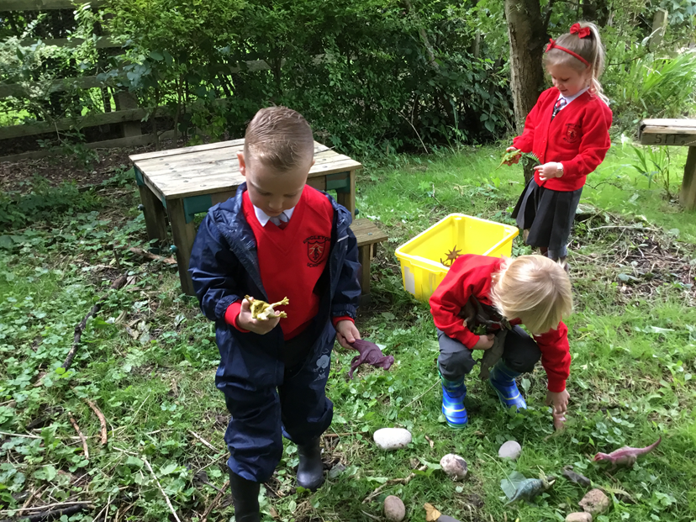
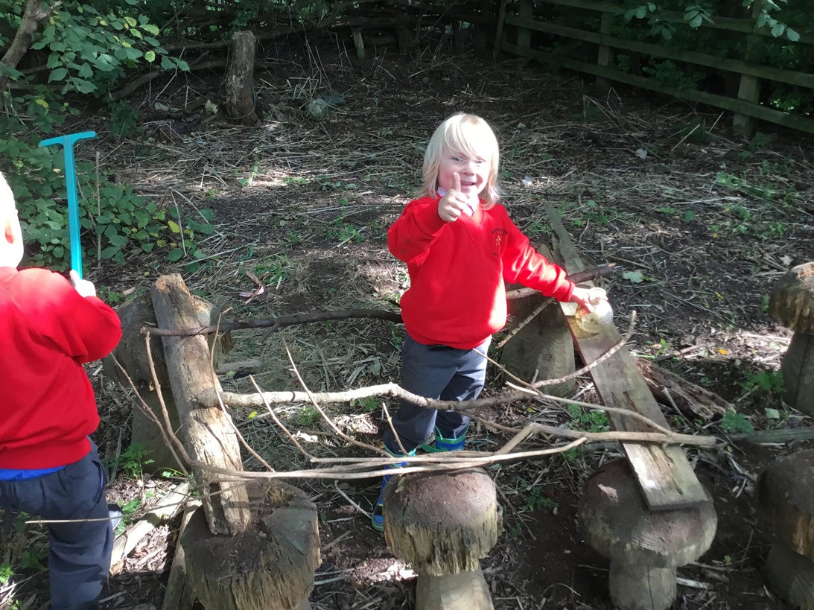
Outdoors
Children gain enormous benefits from learning outdoors. Ideally they should have access to outdoor space on a daily basis – regardless of all except the worst weather. Being outdoors allows them to move around without many of the restrictions of being inside. They can fill their lungs with clean air and use all of their senses to appreciate the colours, different noises, the sense of space and of scale. Being outdoors supports confidence and allows opportunities for big scale play, problem-solving and creativity in the company of other children. Physical activity is enhanced. So is calculated risk taking. In the outdoors, children’s use of language is five times greater than indoors.
Notes:
READ THROUGH THE SLIDE…”Although we go outside all the time we’re just at the end of a brilliant ‘Forest School Week’ where the children have been involved in lots of child inspired activities, culminating in a fire where we toasted marshmallows.”

Slide 23
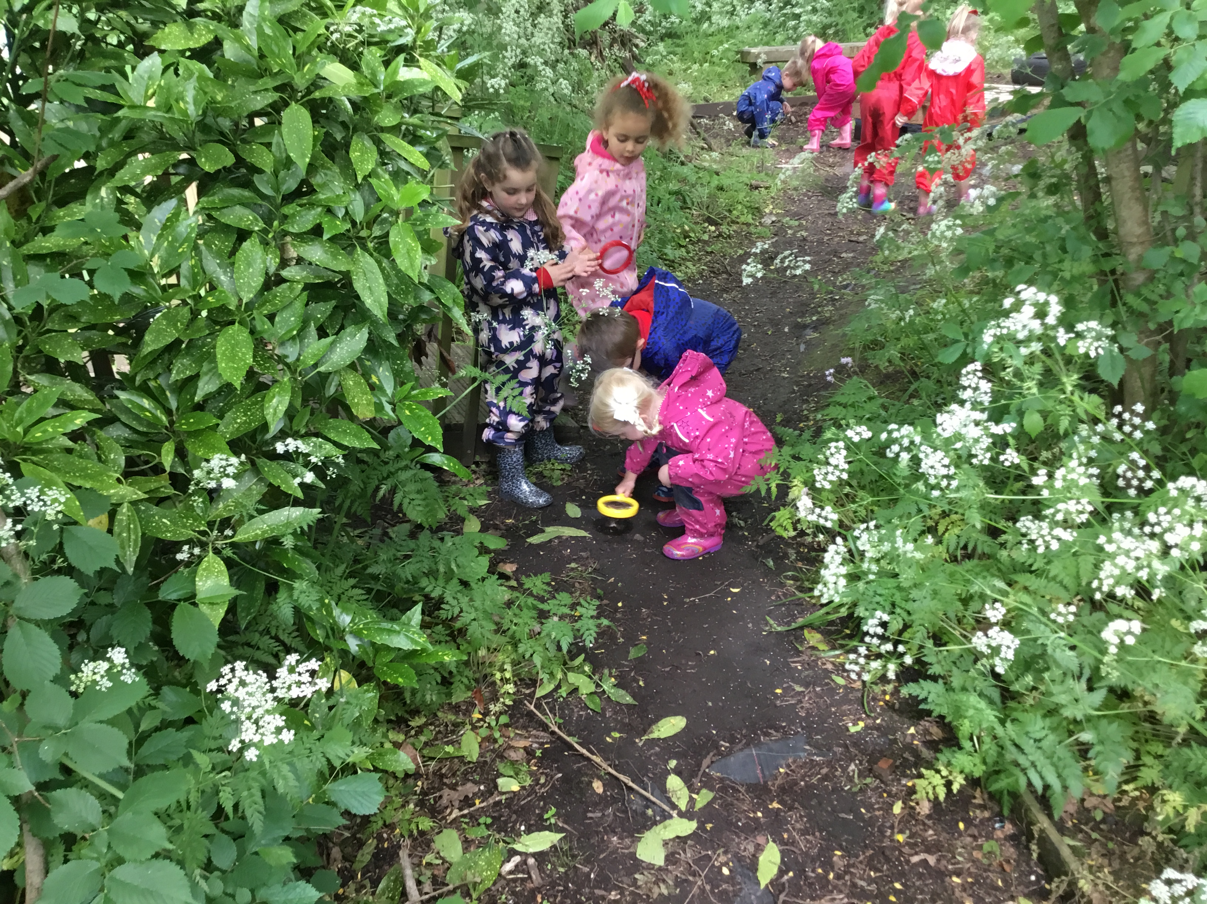
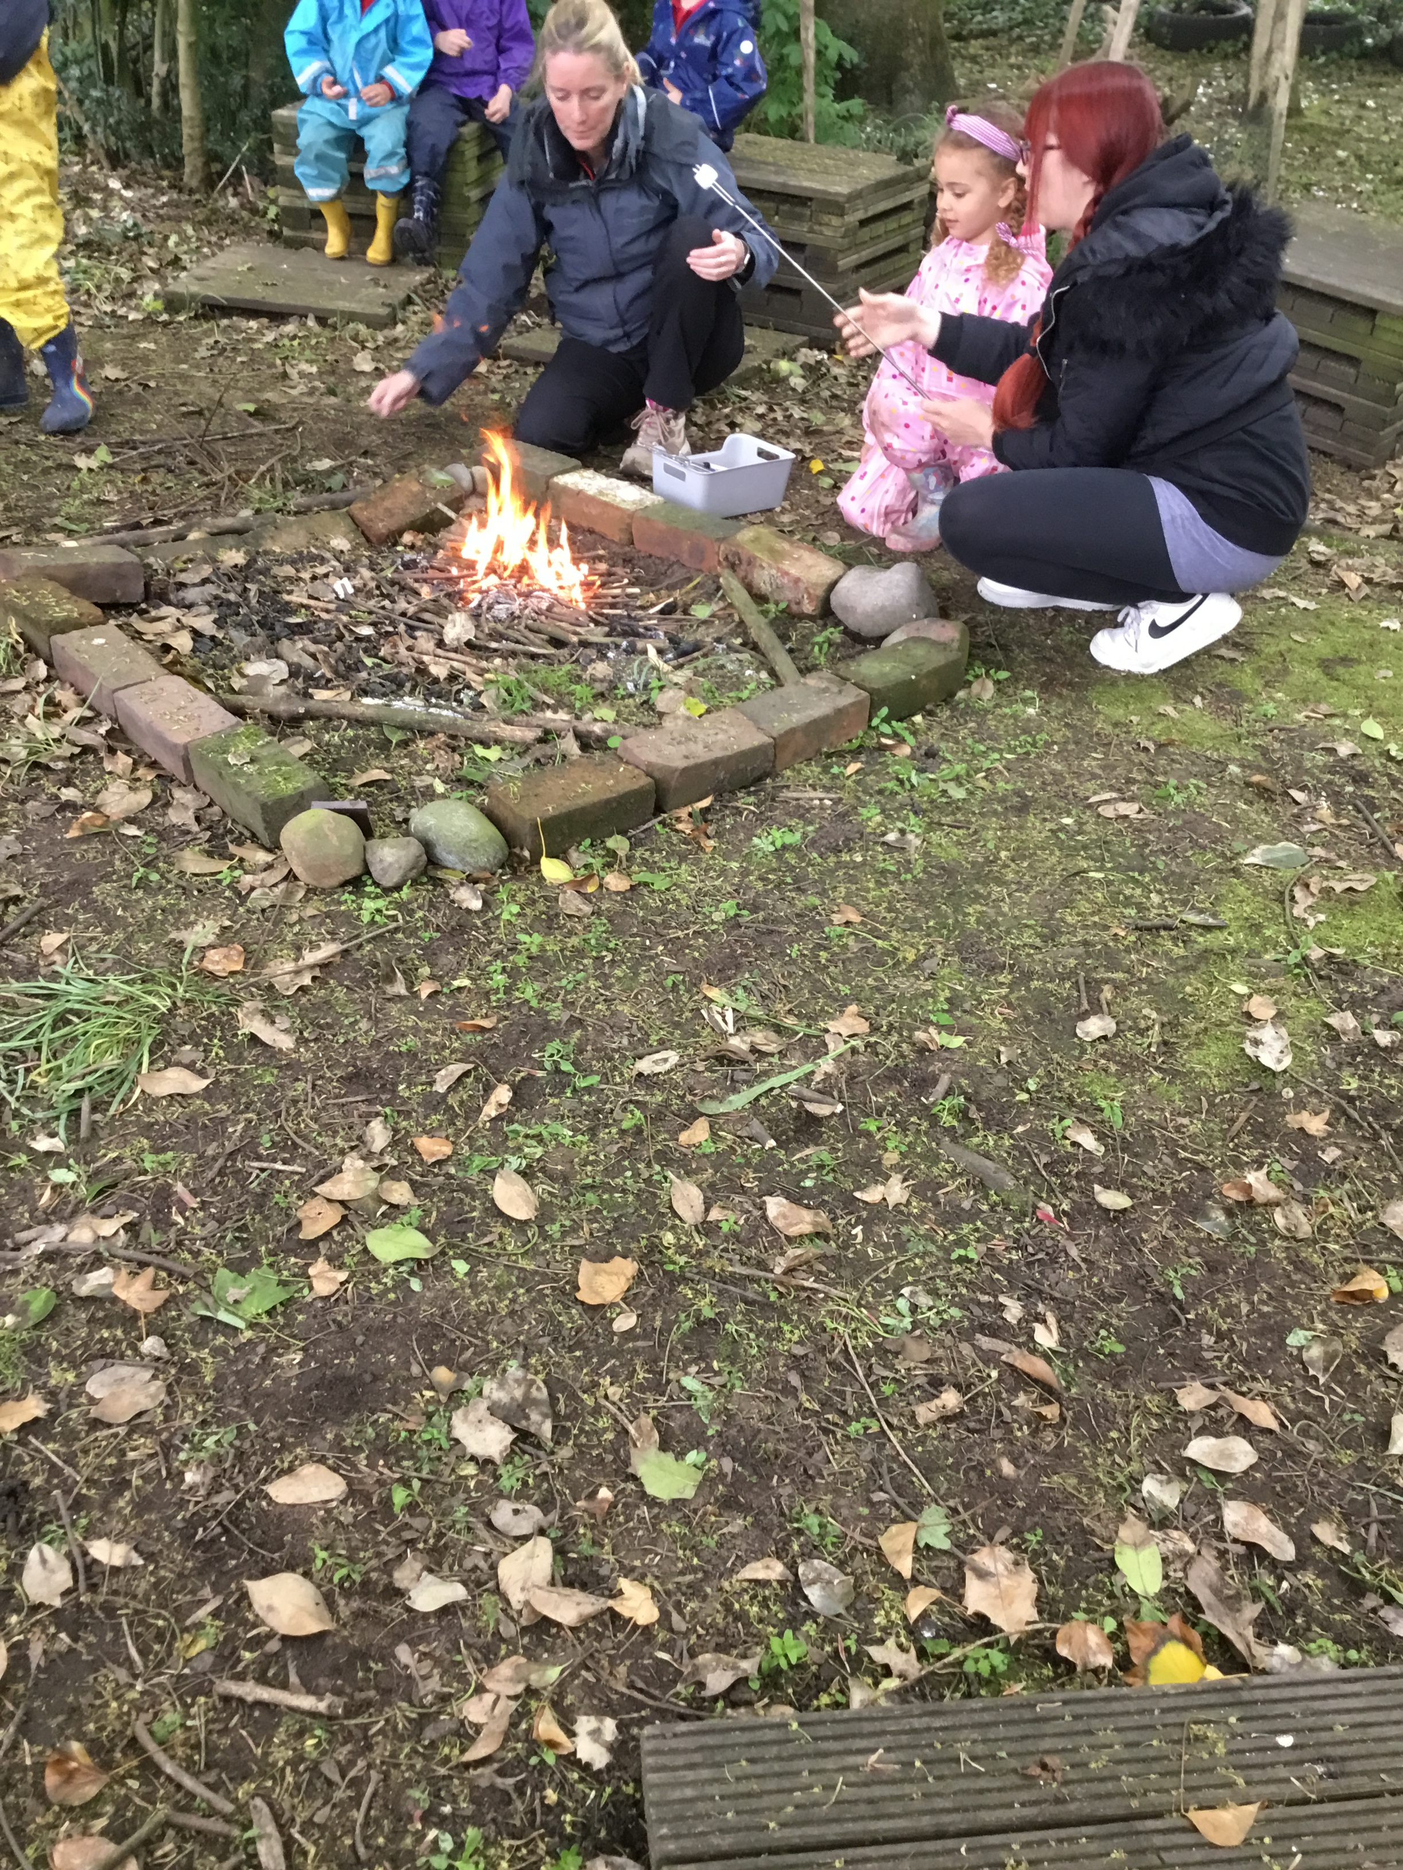
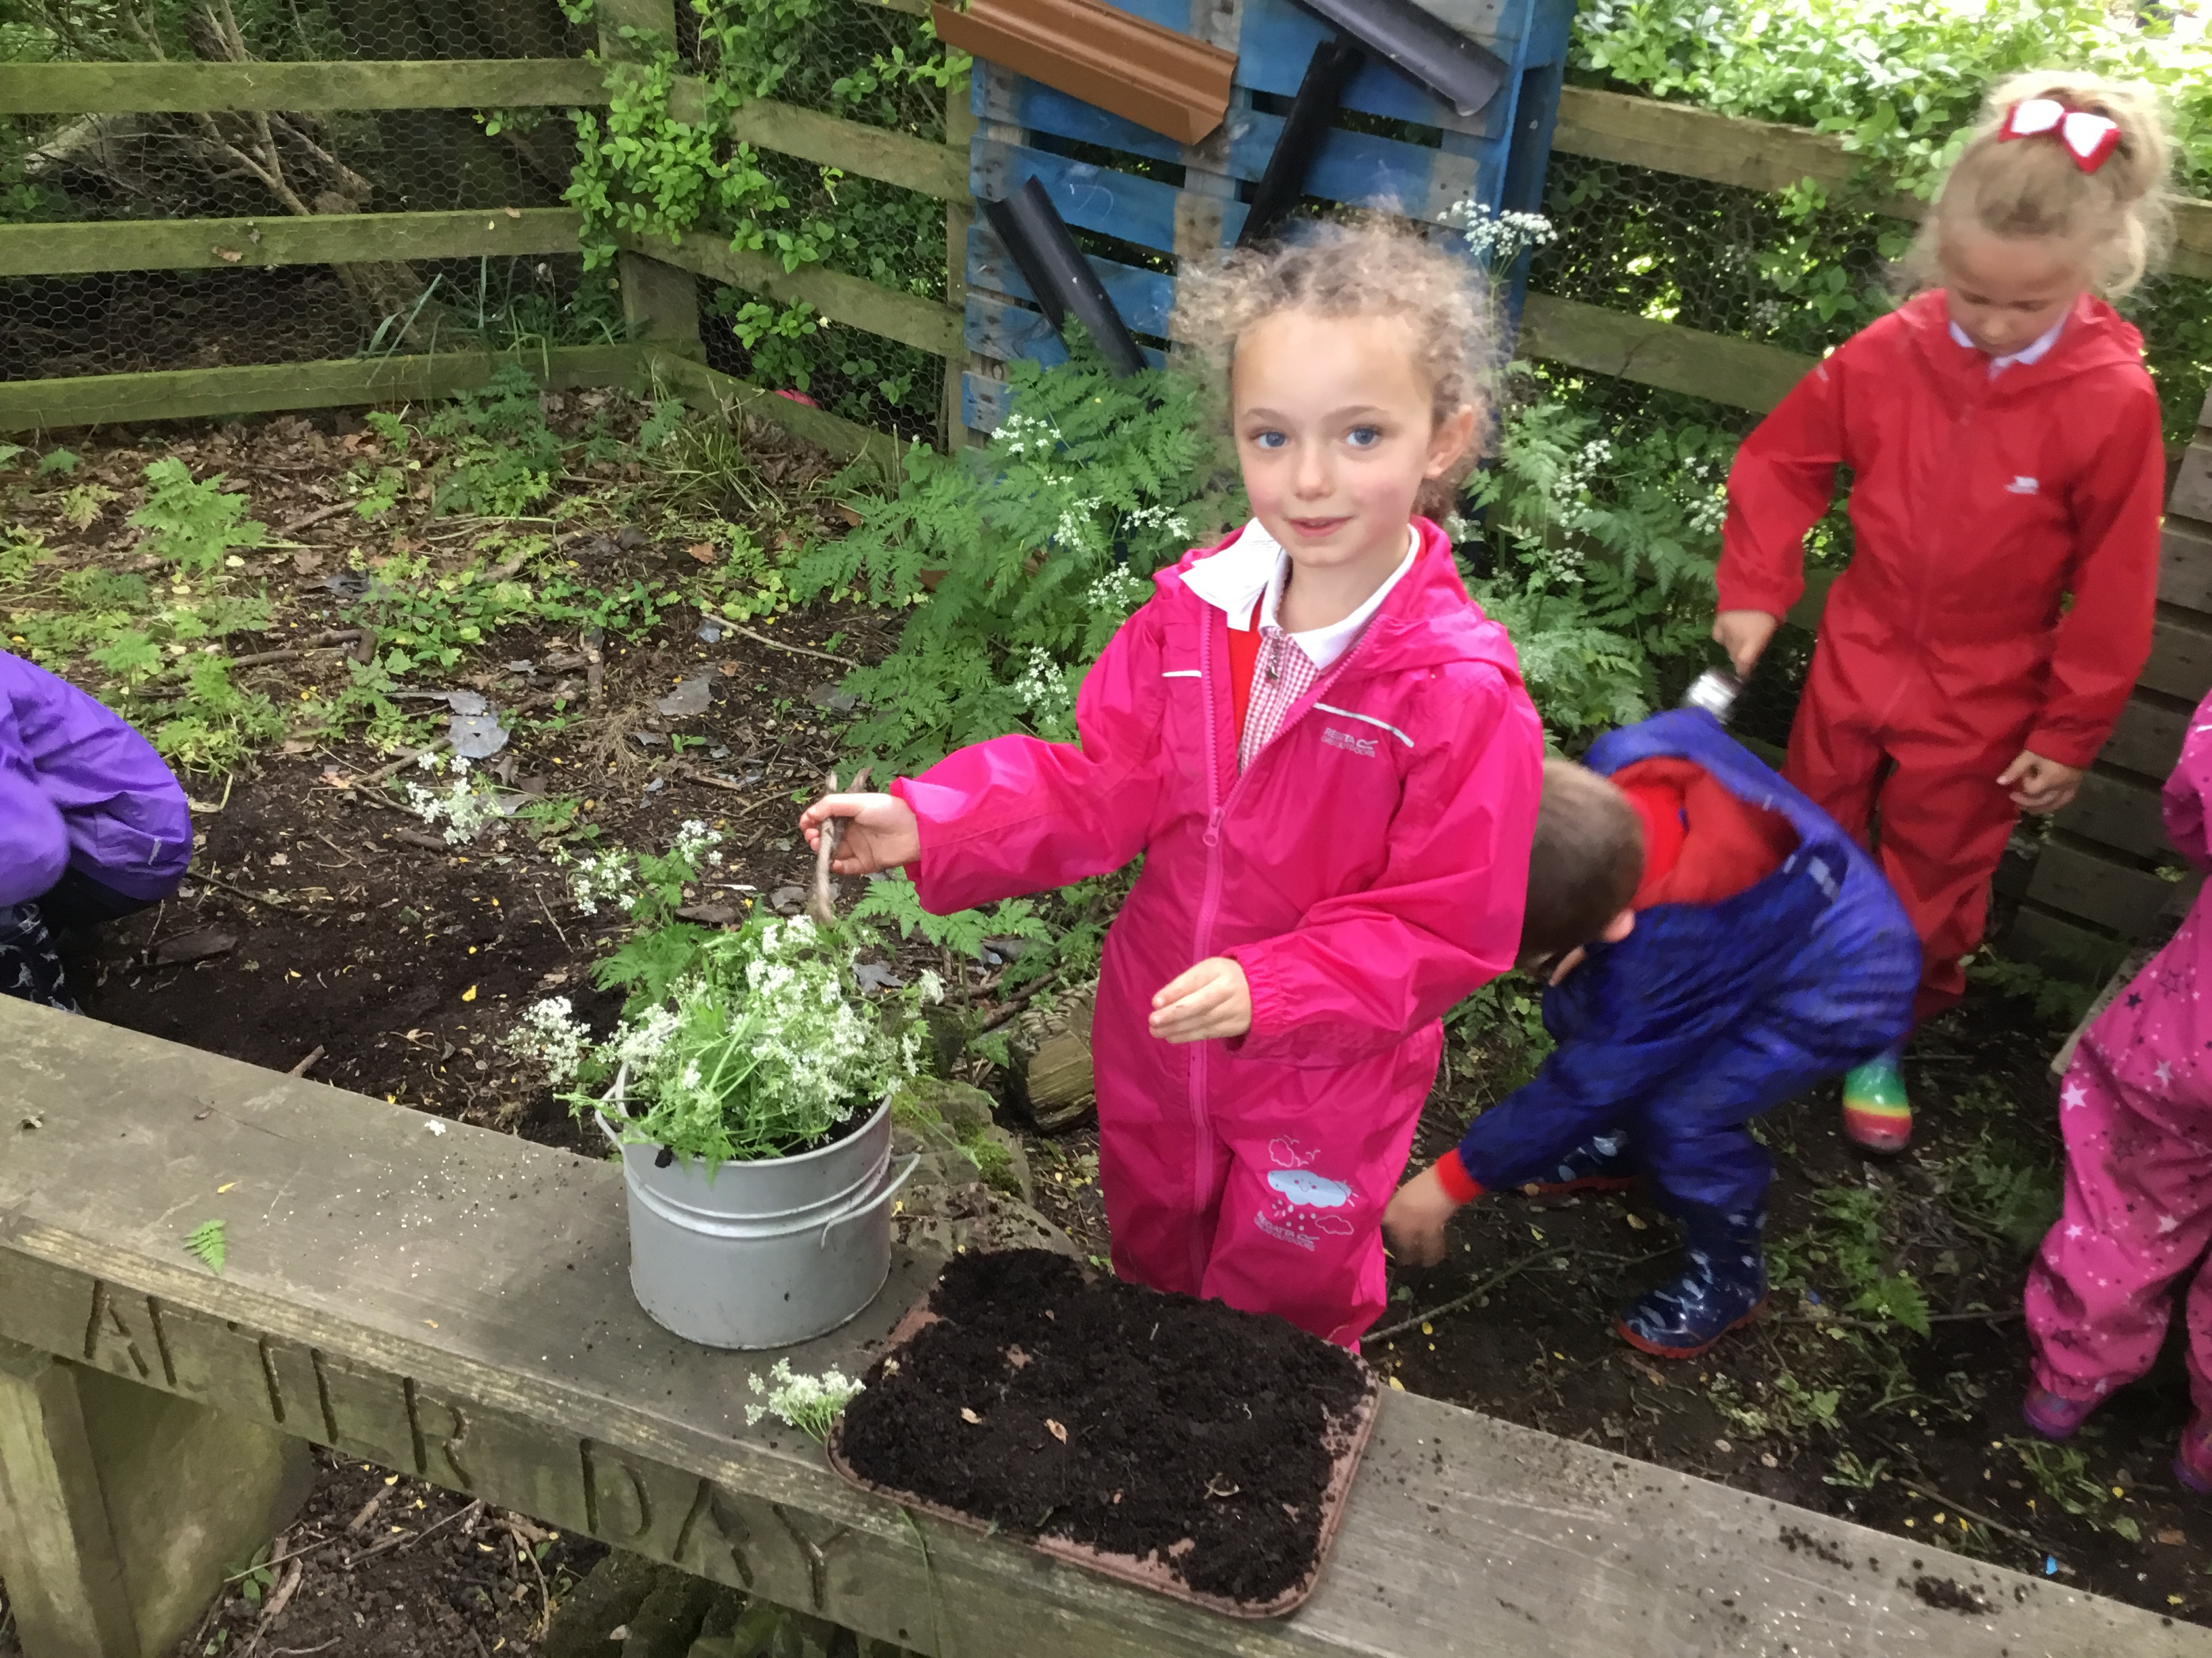
Forest Schools
Forest School is a unique educational experience and process that offers children the opportunity to succeed and develop confidence and self-esteem through hands-on learning experiences in a woodland environment.
Children engage in motivating and achievable tasks and activities throughout the year and in almost all weathers, with the appropriate footwear and clothing. Children will work with tools, play, learn and begin to understand the boundaries of behaviour, both physical and social They will grow in confidence, self-esteem and motivation whilst developing an understanding of the natural world.

Slide 24
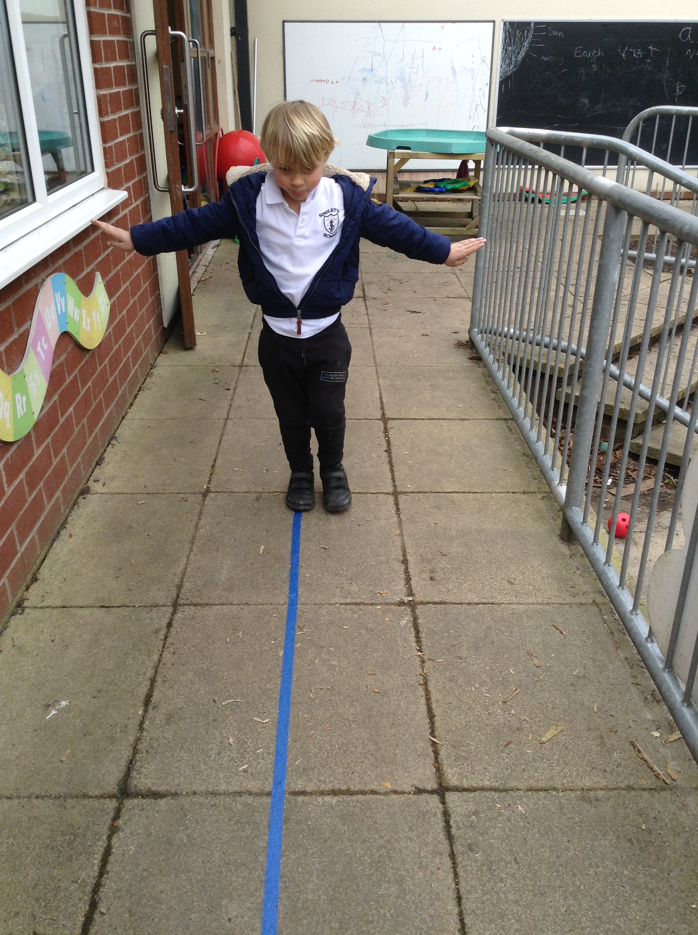
Growing and supporting children’s emotional resilience
Emotional resilience for children, is about bouncing back from challenges they may experience in life: from problem solving in their play and using different tools, to moving home, starting school, bereavement, or family break up. The building of resilience helps children deal with the here and now, but also develop skills and habits that will help them deal with challenges throughout their life.
Notes:
READ THROUGH THIS SLIDE…”Our children engage in many activities where if at first they don’t succeed we encourage them to try and try again, building resilience and a sense of perseverance.”

Slide 25
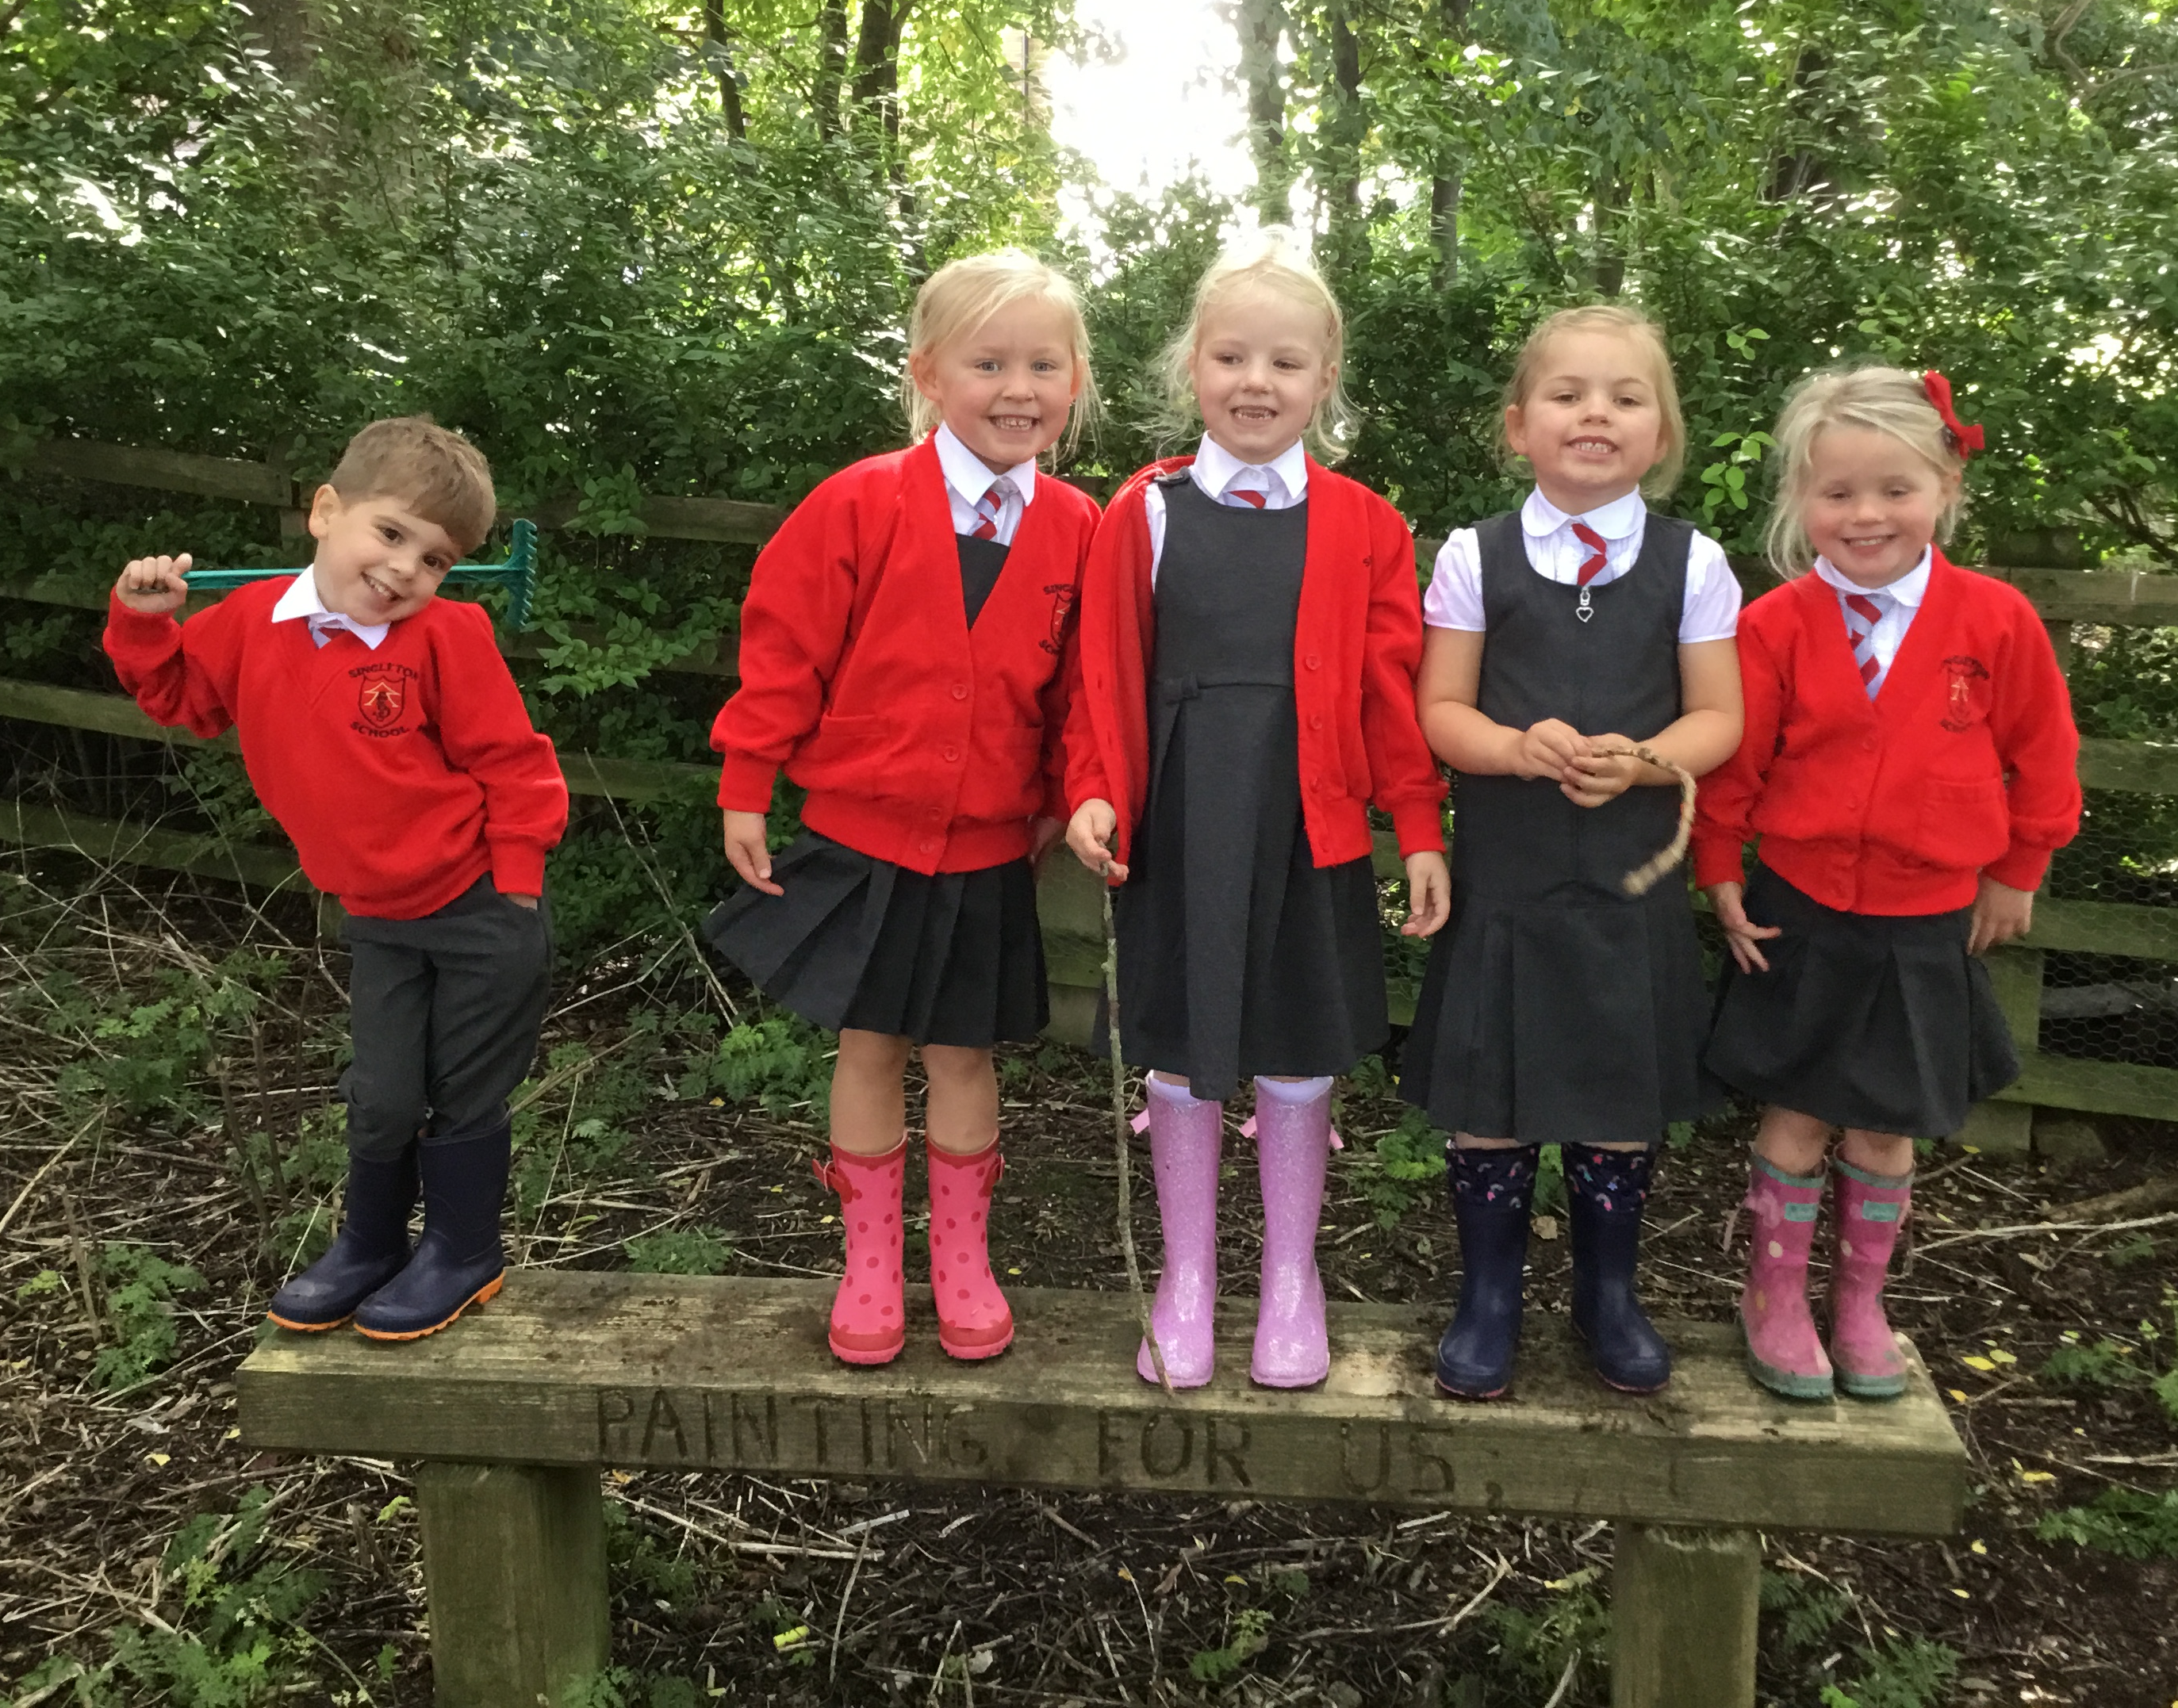
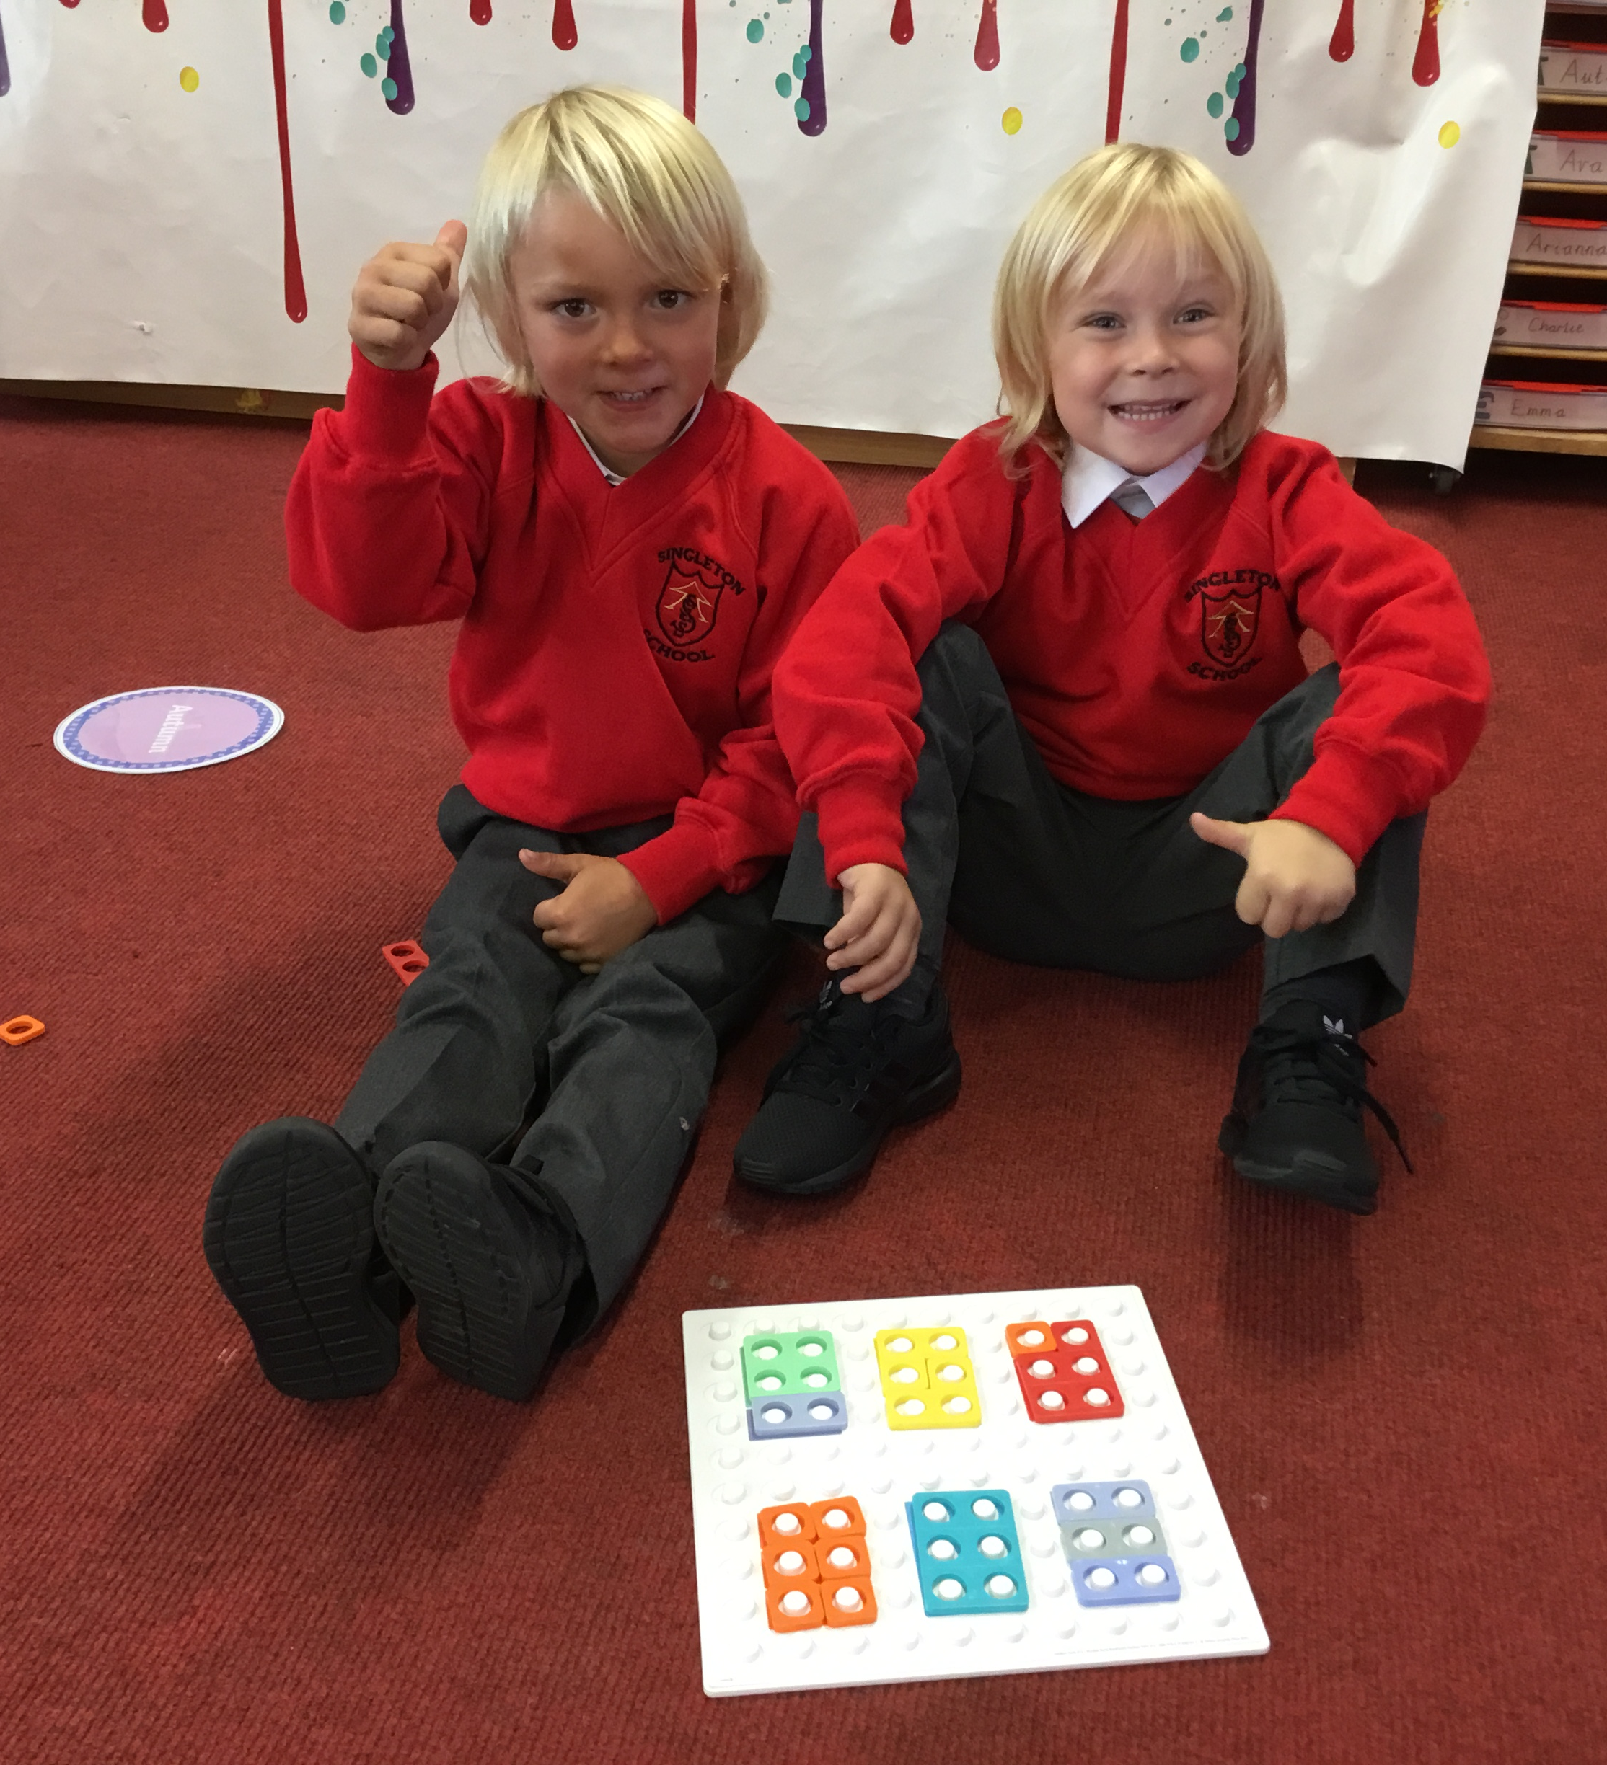
Personal , Social and Emotional Development
Children’s personal, social and emotional development (PSED) is crucial for children to lead healthy and happy lives, and is fundamental to their cognitive development. Underpinning their personal development are the important attachments that shape their social world. Through supported interaction with other children, they learn how to make good friendships, co-operate and resolve conflicts peaceably. These attributes will provide a secure platform from which children can achieve at school and in later life.
Notes:
READ THROUGH THE SLIDE…

Slide 26
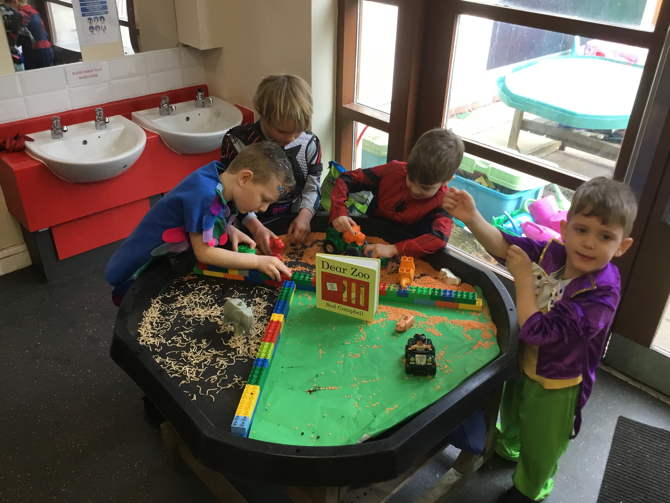
Enabling environments
Children learn and develop well in enabling environments with teaching and support from adults, who respond to their individual interests and needs and help them build their learning over time.
Notes:
READ THROUGH THE SLIDE…2Our continuous provision provides lots of opportunities for this as you can see in the following slides”

Slide 27
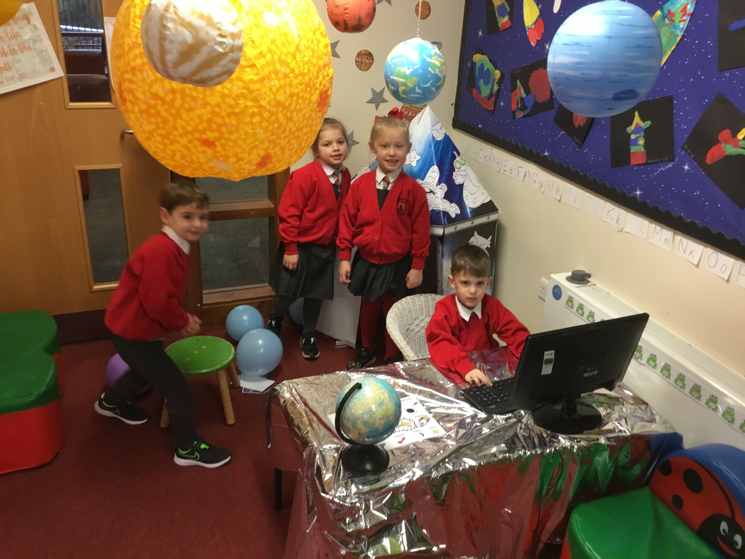
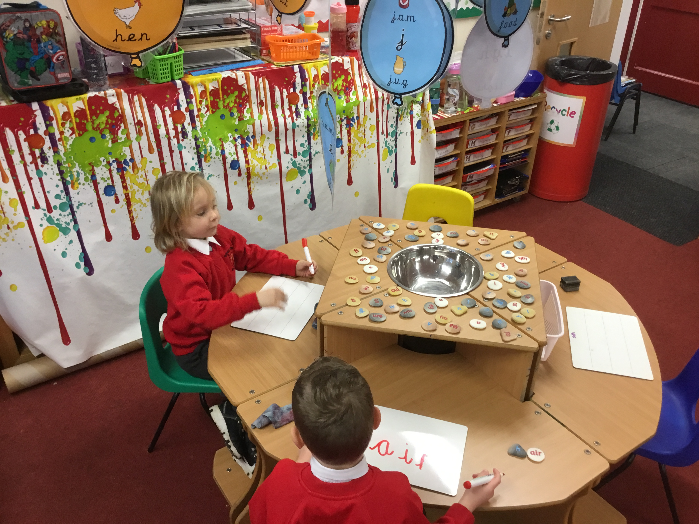
Role Play
Writing words with grapheme pebbles

Slide 28
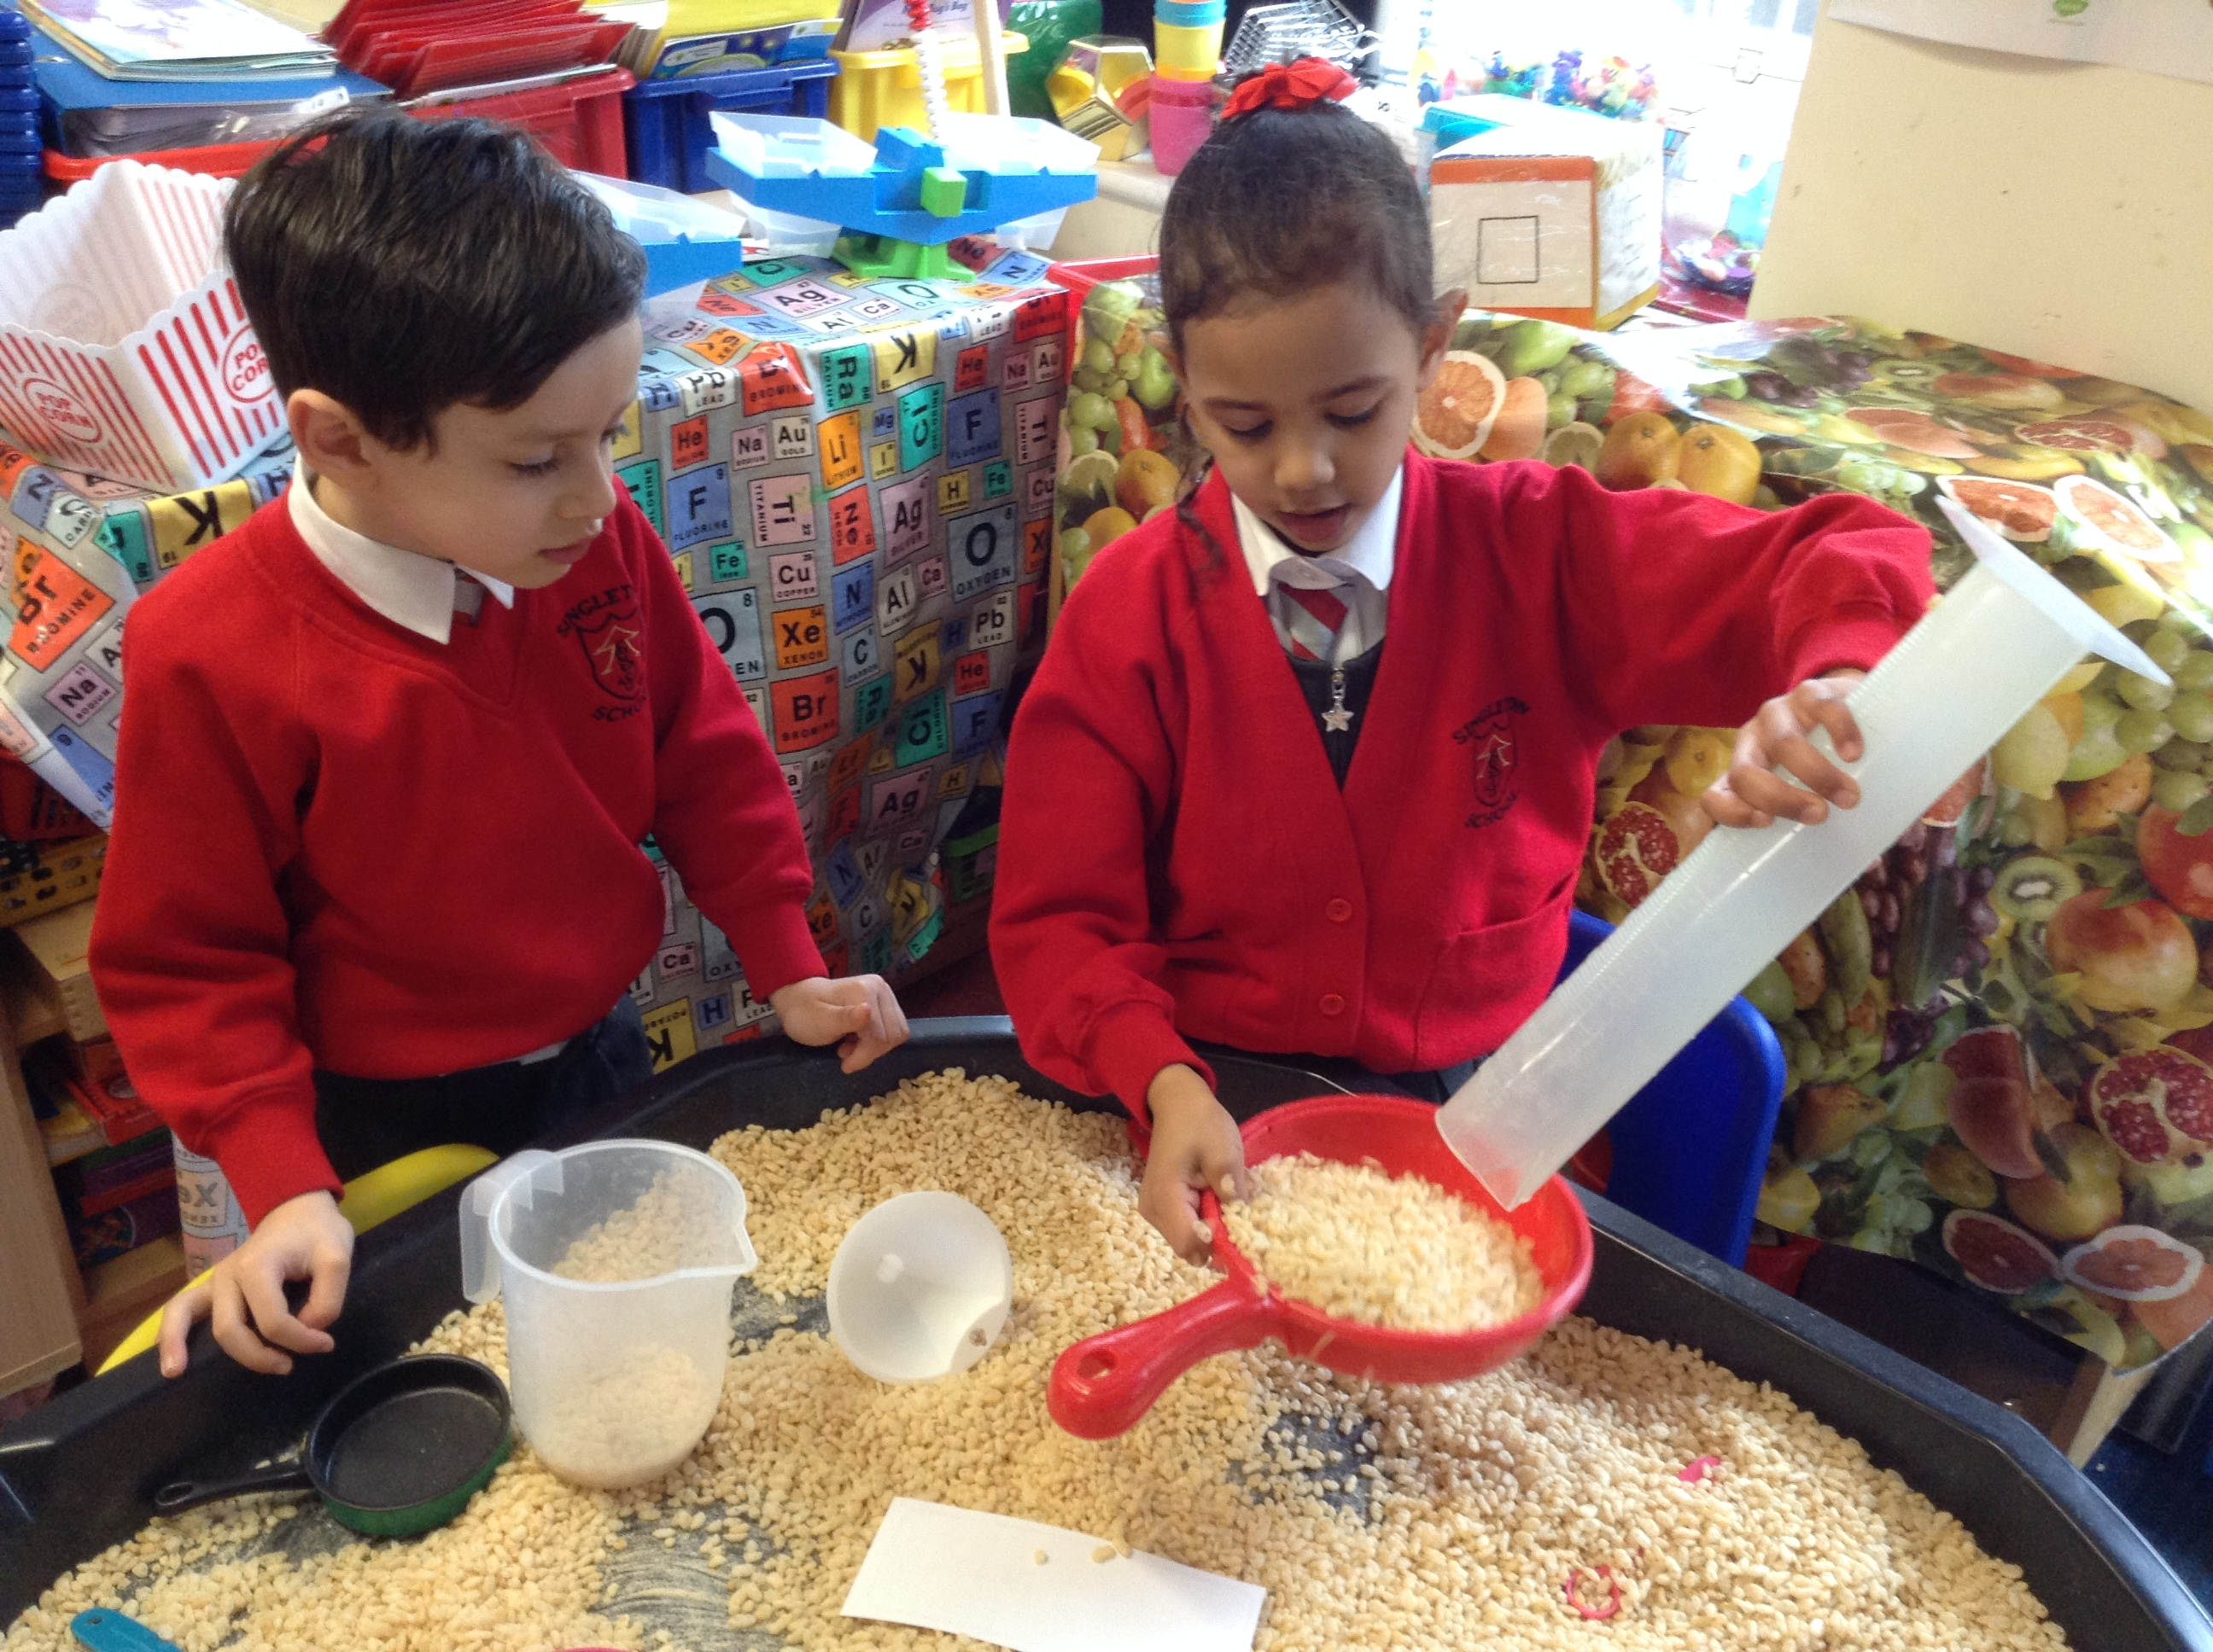
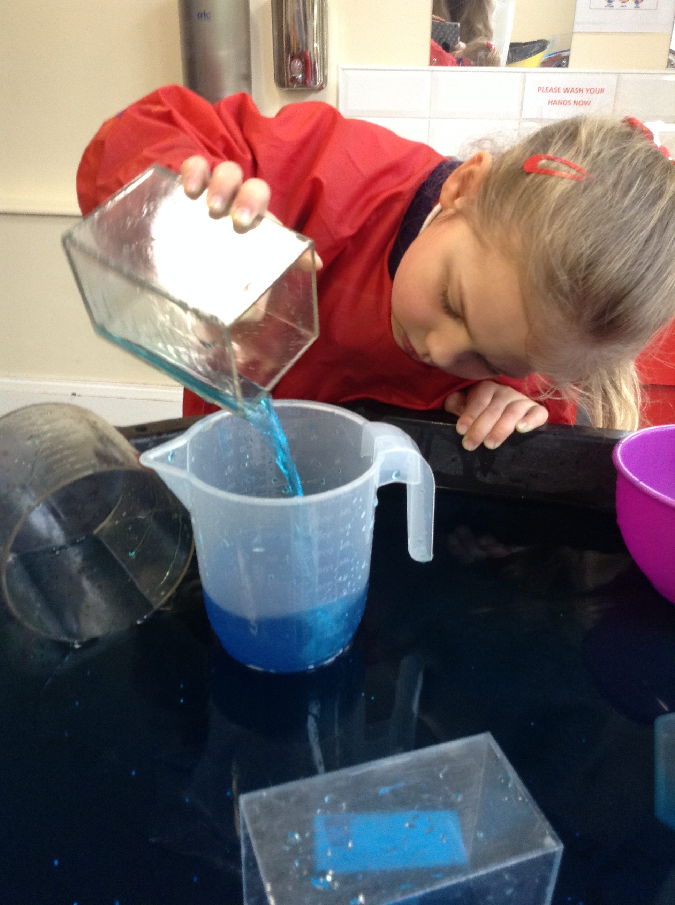
Exploring capacity

Slide 29
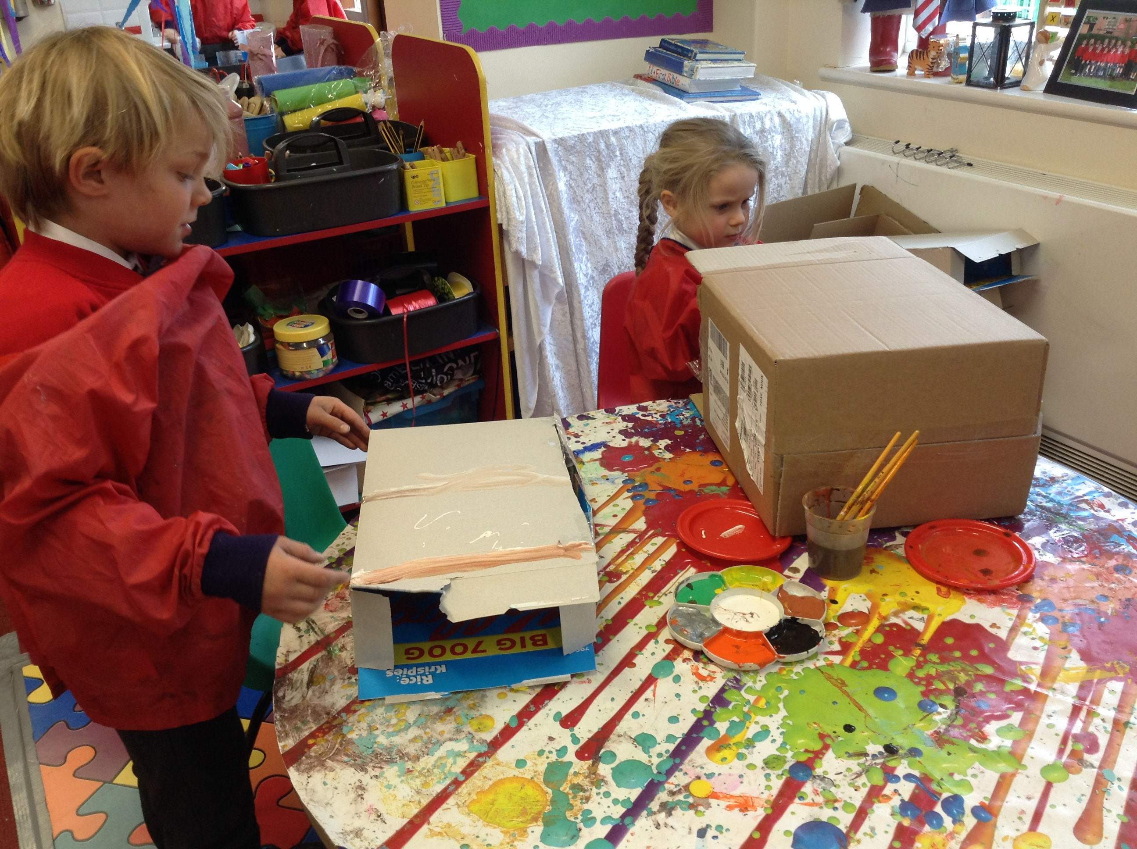
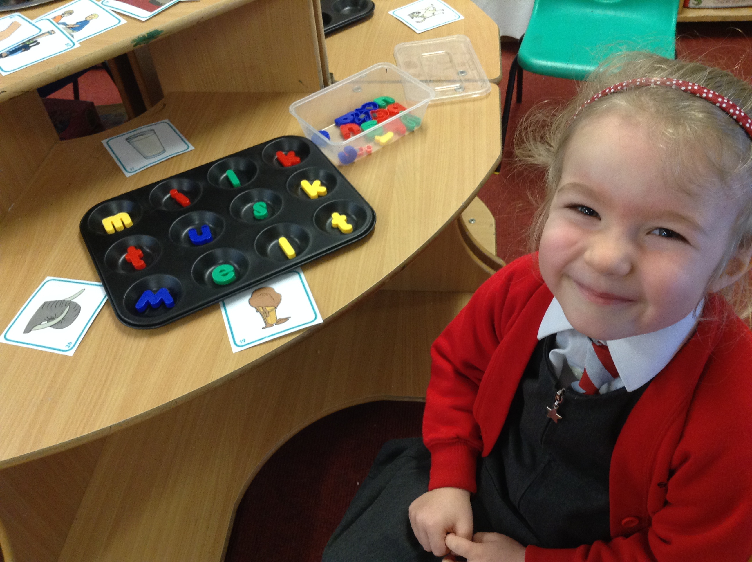
Spelling words CVC, CVCC and CCVC words with magnetic letters
Being imaginative

Slide 30
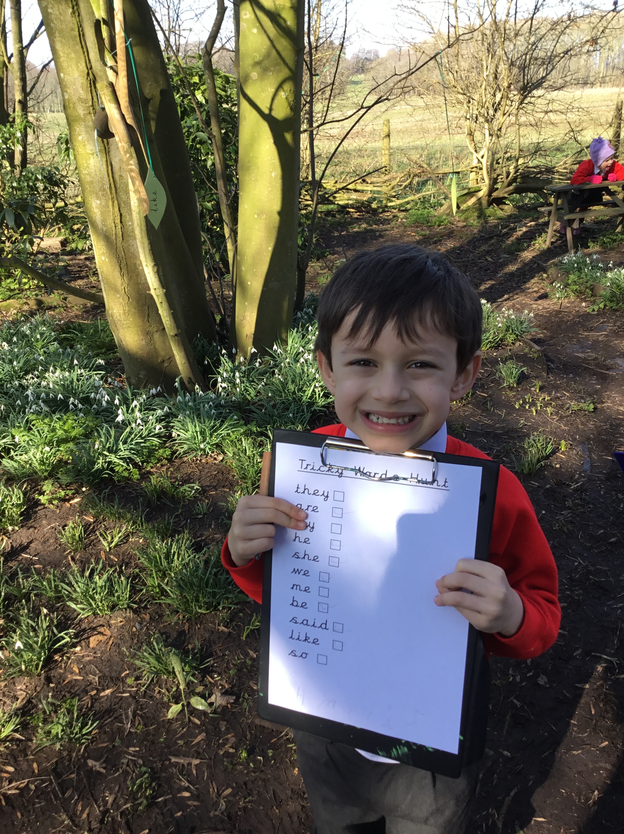
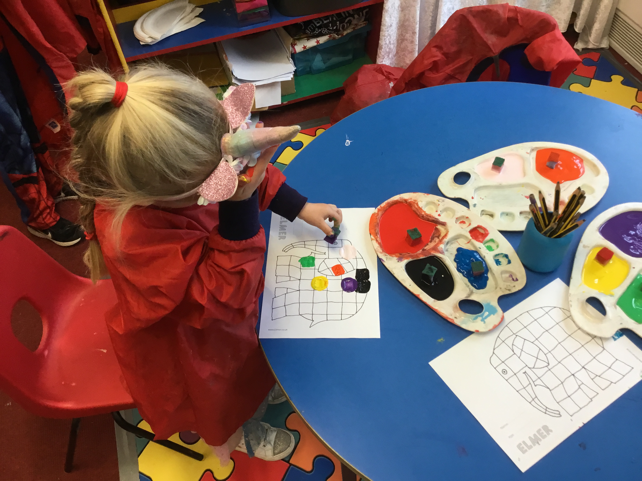
Exploring artistic effects
Reading tricky words

Slide 31
Further opportunities...
You probably feel like you've already been provided with a wealth of information this evening and you've no doubt got lots to go away and digest.
When your child starts school in September we will provide further opportunities for you to come into school to learn more about how you can best support your child in their learning journey, both academically and socially and emotionally.

Slide 32
I will now pass you over to our wonderful Office Manager, Mrs Reeves.

Slide 33
In your pack…
As well as the booklets I’ve already discussed, your pack also contains our Parent Handbook/frequently asked questions booklet, this contains everything from useful telephone numbers to information about behaviour, after school clubs and lots more. There are also holiday dates, a booklet on Phonics & Reading and a Pupil Booklet which is useful to share with your child before they start school.
Notes:
READ THROUGH SLIDE… “As I said, if you haven’t already collected your pack you can do so when school reopens on the Monday 7th June.

Slide 34
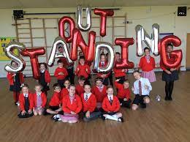
Thank you!
It’s been great to meet you and I look forward to working with you all during the forth-coming school year.

