Slide 1
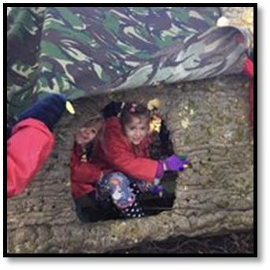
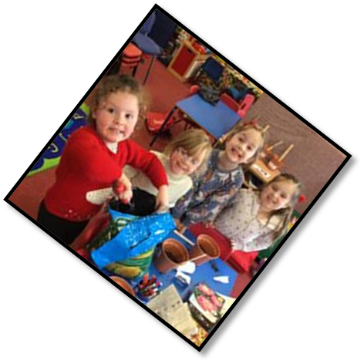
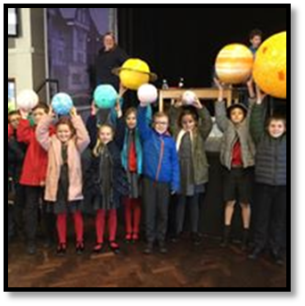
Singleton C of E Primary School
School Improvement Plan 2021 - 22
“Passion for Learning….Passion for Life”
Leadership and Management
Mrs Clayton is going focus on our wellbeing and the wellbeing of all the staff in school. Miss Ashworth the Learning Mentor is going to help with this.
Mrs Clayton and Mrs Marshall are going to research and develop ‘Learning to Learn’. They will then train up the staff on this so they can help us understand what type of learners we are and how we learn best.
Quality of Education
Curriculum development
Mrs Rund will continue to lead all the staff in developing a bespoke curriculum that meets the needs of all our children. We want to make sure that our curriculum is ambitious, and that we challenge you to think and have high expectations for yourself. We want to make sure that it is planned and sequenced so that you learn in the best possible way. We want to make sure that we offer you a wide range of opportunities to learn new things so that you are inspired to learn and that you can develop your skills, knowledge and talents
Behaviour and Attitudes / Personal Development
Miss Ashworth wants to develop play at playtime. She wants to work with the JLT to come up with ideas as to how we can teach the younger children to play. She would like the older children to lead games on the playground.
Mrs Ashworth is also working on behaviour for learning she wants to work with the JLT to help her develop …resilient, motivated, independent and passionate learners in our school
Quality of Education
Mrs Clayton and Mrs Millward are going to ensure that the ‘Recovery Curriculum’, helps us catch up with learning that was lost due to COVID.
Mrs Rund is also going to lead the development of ‘Cultural Capital’ within our curriculum, looking for ways in which we can enrich the learning opportunities and experiences we have. Mrs Clayton will ask all staff and the Junior Leadership to look at ‘Cultural Capital – and think about what it means for our children and our school. The JLT will help in deciding on the enrichment opportunities that we provide.
Behaviour and Attitudes / Personal Development
Miss Ashworth and Mrs Rund are going to focus on developing resilience across school. Having resilience reduces stress and anxiety, it helps us have self esteem and a growth mindset, it also helps us cope with low level behavioural incidents.
Behaviour and Attitudes
This year Mrs Marshall is going to develop a new system for supporting you with your learning. She is going to research and put together some resources so that we can teach you how your brain and your memory work. This will be called ‘Learning 2 Learn’
You will also learn about what type of learner you are so you can help your self with learning.

