Slide 3
Notes:
Talking points:
What do you know about VE Day?
What do members of your family know or remember about VE Day? Were any of them there?
Activity
Listen to Churchill’s full speech here: https://winstonchurchill.org/resources/speeches/1941-1945-war-leader/end-of-the-war-in-europe/
Consider: How do you think people felt hearing those words on the radio?
Overview
VE Day or Victory in Europe Day marked the end of fighting in Europe during the Second World War – which had lasted nearly 6 years.
On 7th May 1945, Winston Churchill announced on the radio that Germany had officially surrendered.
He declared that the next day (8th May) would become Victory in Europe day and a national holiday for everyone.

Slide 4
Why do you think it is important that together we remember VE Day?
Notes:
Talking points:
Why was VE day such an important day?
Why do you think it is important that we remember VE Day?
Overview:
This year it is the 75th anniversary of VE Day – which means that 75 years ago on the 8th May, war in Europe ended.
To commemorate the event, the early May bank holiday (usually a Monday) has been moved so that the bank holiday is the same day as VE Day – Friday 8th May.

Slide 5
Notes:
Image : © Norman Dunn
Talking Point:
Why did people come together on VE Day to celebrate?
How do you think the people in this picture were feeling?
Activity
Create a soundscape!
Look closely at the picture and now imagine you are in it– list all of the sounds you can hear.
Overview
On VE Day, people held big celebrations across Britain such as parades or street parties.
The largest crowds were in London with one crowd reaching up to 50,000 people celebrating into the night.
Huge crowds also gathered outside Buckingham Palace where the King and Queen, their daughters and the Prime Minister appeared on the balcony to greet everyone.

Slide 6
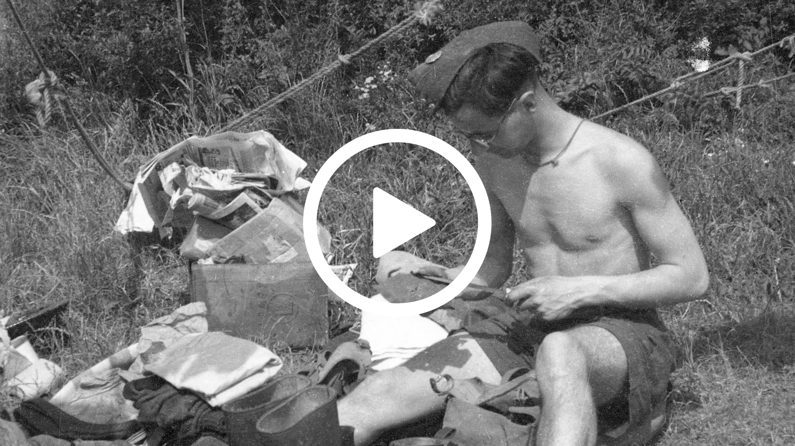

Slide 7
Notes:
Talking Point:
Why do you think people felt both victorious and sad on VE day? What were they celebrating?
Why was VE day still a sad day for many?
What things have you felt triumphant about – what achievements have you been proud of?
Overview:
Winston Churchill gave a speech recognising the importance of remembering those who lost their lives. On VE day, there was a mix of feelings. It was a time for celebrating the end of the war, but it wasn’t only a celebration, it was also a sad time because:
Millions of people had lost their lives or loved ones in the conflict.
There was a lot of damage after the war, for example many people’s homes were destroyed in the air raids.
Soldiers who survived and were able to return home were full of the memories of war and conflict
Many people weren’t home yet - including Prisoners of War or evacuees

Slide 8
Notes:
Talking points:
Many lost people they loved in the war – how might this have affected how they felt on VE day?
Overview
Between 50 – 60 million people died in WW2.
Out of those deaths, 45 million were civilians (people not serving in the armed forces).
Nearly 18 million service personnel were killed on the battlefields in Europe, including 11 million Allies.

Slide 9
Notes:
© Crown Copyright. IWM This image was taken on VE Day - two small girls waving their flags in the rubble of Battersea, London.
Talking points:
What can you see in the background of the picture and on the floor?
What might the girls in the picture be looking at?
How might the be feeling? What could they be thinking?
Activity
Complete thought bubbles to show what the two little girls might have been thinking and feeling on VE Day
Overview
Homes, building and streets had been damaged across the UK during the war.
Everyone had worked hard to end the war but there was still a lot more work to do – the country needed to be rebuilt.

Slide 10
How do you think returning soldiers felt about coming home?
Notes:
Talking points:
How do you think soldiers felt about returning home?
Overview
For those soldiers who survived and returned home at the end of the war, it wasn’t all about celebration.
Many were distressed about what they had seen and experienced during the war.
Those returning home included surviving Prisoners of War (POWs) – soldiers who had been captured by enemies.

Slide 11
Notes:
Image © Crown Copyright. IWM
Talking points:
How would it feel to not be able to go back to your home? What would you miss?
Activity:
Draw a picture of your home. Label some of things that you would miss the most.
Overview:
On V.E Day, although some people were at home taking part in the celebrations, there were still many people who had not made it home yet.
There were approximately 40 million refugees scattered across Europe trying to get home.
Millions of people never even returned home at all and some had to find new homes in different countries.

Slide 12
Notes:
Talking points:
What would it have been like to be an evacuee?
What things might Michael have missed about being at home?
How do you think Michael felt on VE day?
Overview
Michael was one of many children who were evacuated from London during the war.
Evacuees were sent to live with other families in safe areas of the country whilst London was being bombed.
Michael's experience stayed with him forever, and throughout adulthood he dedicated himself to helping others.
He became a teacher and supported charities like Save the Children.

Slide 14
Notes:
Talking point:
What kinds of celebrations could you have at home to mark the occasion?
Activity:
Use the ideas on the next slide/download sheet to help you make a plan for celebrating VE Day at home.
Overview:
Commemoration of VE Day will take place on Friday 8th May across the world.
Home celebrations will be vitally important to ensure everyone remembers VE Day and remembers the sacrifices made.

Slide 15
Download template
Notes:
Talking Points:
What sort of food would people have eaten during wartime Britain?
Activity:
Design a VE Day party menu. What will you choose for a starter, main and dessert? What drinks will you serve? What would the dress code be?
Brief Overview:
Some helpful links to wartime recipes:
https://www.nationaltrust.org.uk/croome/recipes/wartime-carrot-cake – wartime carrot cake
https://www.english-heritage.org.uk/siteassets/home/visit/ve-day-75/ve-day-pack.pdf – party pack includes recipes for carrot scones, cheese and marmite swirls, lemonade
http://downloads.bbc.co.uk/history/handsonhistory/ww2_recipes2.pdf – wartime chocolate cake
Helpful links to find out more about wartime rationing:
Further info on wartime rationing https://www.lavenderandlovage.com/2012/11/the-wartime-kitchen-living-of-rations-with-ration-book-cooking-day-one.html including a loaf recipe

Slide 16
Download template
Notes:
Talking Points:
How can we remember the past and build a peaceful future together?
Activity:
Make a bright and colourful poster with clear messages of peace on. The poster could be displayed in a window or shared through an adult’s social media account.
Peace in other languages:
Paix – French
平和 – Heiwa - Japanease
Frieden – German
Paz – Spanish
Pokój – Polish
Salam - Arabic

Slide 17
Download template
Notes:
Talking Points:
Why is important to remember people’s experiences of VE Day? Is there anyone in your family who might be able to share a wartime story with you?
Activity:
Take yourself back in time and a write a diary entry describing what it was like on VE Day – what did you do to celebrate? Was anyone missing? Why might it have felt sad as well as celebratory?
Helpful Links:
Book lists/reading suggestions for children’s WW2 fiction:
https://www.booktrust.org.uk/booklists/w/world-war-ii-childrens/
https://www.lovereading4schools.co.uk/lists/12025/World-War-Two-WW2
https://tompalmer.co.uk/after-the-war/

Slide 18
Watch the Lindy Hop
Notes:
Talking Points:
Why do you think dancing was such a popular form of entertainment in the 1940s?
Activity:
Learn some 1940s dance moves! Find out what the Lindy Hop was and see if you can learn it with the help of someone at home! You could perform it for your family or even create a dance tutorial for others to learn the moves.
Brief Overview:
https://www.english-heritage.org.uk/siteassets/home/visit/ve-day-75/ve-day-pack.pdf – party pack includes Lindy Hop dance moves to learn and some 1940s songs

